Slide 1
“Do Words Matter?”
Jeanine Maddox and Angela McClure

Slide 2
INTRODUCTIONS

Slide 3
WHO WE ARE
Jeanine Maddox
8th Grade English, SKMS, Harrisonburg, VA
BA in English Literature; BA in Secondary English Ed.; MS in Literacy Education
14 years teaching, mostly 7th and 8th grades, but also Kindergarten and 4th grade
Angela McClure
8th Grade English, SKMS, Harrisonburg, VA
BA in Secondary English Ed.; MS in Curriculum and Instruction; Post-Grad Certificate in Teacher Leadership
13 years teaching, all in the middle grades

Slide 4
WHAT THIS IS
“Do Words Matter?” is a thematic unit about the power of words. It integrates multiple strands to engage students in authentic reading and writing.
Our complete instructional plan is linked on the VDOE website.

Slide 5
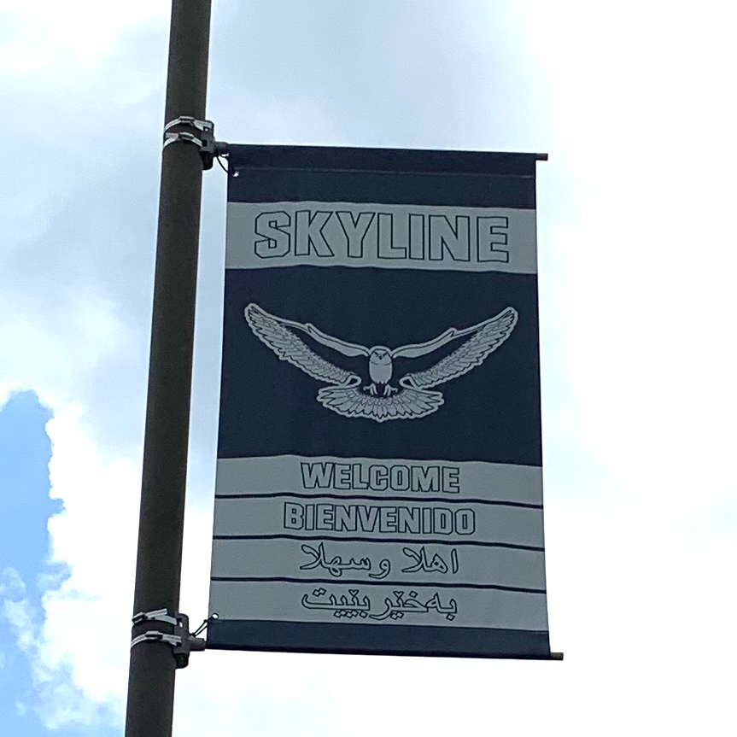
WHERE and WHEN
Demographics of our School
Harrisonburg City Public Schools
Students/Families/Communities
Pandemic-Teaching Factors
Technology
Engagement
SOL - District Assessment
Class Set-up this Year
50 minute class periods
Twice a week

Slide 6
GRADE 8 PRIMARY SOLs
Reading
8.6d - Make inferences and draw conclusions based on explicit and implied information using evidence from text as support
8.6e - Analyze the author’s qualifications, viewpoint, word choice, and impact
8.6k - Evaluate, organize, and synthesize information for use in written and other formats
8.6l - Analyze ideas within and between selections providing textual evidence
Writing
8.7a - Engage in writing as a recursive process
8.7c - Use prewriting strategies to generate and organize ideas
8.7f - Compose a thesis statement for persuasive writing that advocates a position
8.7g - Clearly state and defend a position with reasons and evidence, from credible sources
8.7h - Identify a counterclaim and provide a counterargument
8.7j - Organize information to provide elaboration and unity

Slide 7
OBJECTIVES FOR THIS PRESENTATION
Preview an engaging and differentiated thematic unit of choice-based reading and persuasive writing about the power of words.
Understand how to use formative and summative assessment tools to measure student growth within the unit.
Discover ways to collaborate with teachers and support staff.

Slide 8
PRESENTATION OBJECTIVE 1
Preview an engaging and differentiated thematic unit of choice-based reading and persuasive writing about the power of words.

Slide 9
Student Learning Goals for this Unit
Connect (8.6d, 8.6e)
Connect prior knowledge to new and culturally-responsive sources.
Develop (8.6k, 8.6l)
Develop perspectives through synthesizing multiple and varied viewpoints on the power of words.
Write (8.7a, 8.7c, 8.7f, 8.7g, 8.7h, 8.7j)
Write persuasively using text-evidence, including a counterclaim, to answer the question, “Do words matter?”

Slide 10
STUDENT GOAL 1: Connect

Slide 11
Student Texts/Sources
District prompt from our textbook led to...
A few textbook unit resources
Online go-to’s (Newsela, Commonlit, TED Talks, NPR podcasts, Poetry Foundation, YouTube)
Multimodal Genres
Fiction, nonfiction, speeches, lyrics/poetry, podcasts, and viewables (murals, ads, graffiti, film)
Grade level and independent reading level text options
Primary Sources
Personal anecdotes and interviews

Slide 12
SAMPLE PAGE IN CANVAS LMS
We designed Canvas pages for each genre and text set. These followed the same order as the students’ Evidence Trackers.
Students were required to complete a minimum of one response per genre.

Slide 13
Student Evidence Tracker
Purpose
The evidence tracker is designed to track students’ thinking as they read and build perspectives about words from each source.
The final piece of the Evidence Tracker is to synthesize reasons for and against the power of words.
Format
Suggested options: doc, slide, or web-based applications (ex: Pear Deck)
Students record thoughts on each text choice, as well as determine how that text answers the essential question, “Do words matter?”
Differentiation
Students could use sentence stems for each response.

Slide 14
EVIDENCE TRACKER SAMPLE SLIDE
This slide shows a student response after listening to a Podcast from the Podcast Canvas page. All of the required elements of the response are present:
Podcast title and link
Summary
Quotes from the text
How this text answers the question, “Do words matter?”

Slide 15
STUDENT GOAL 2: Develop

Slide 16
Digital Interaction
Goal
Foster student collaboration and communication during education in a virtual setting.
Methods
Google Meet chat
Google Meet breakout rooms
Google Forms
Google Jamboard
Padlet
Shared documents

Slide 17
DIGITAL INTERACTION EXAMPLE 1
This Padlet exemplifies how students interacted digitally through different applications.
Students wrote their own responses and then could read, react, or respond to their peers’ posts.

Slide 18
DIGITAL INTERACTION EXAMPLE 2
This is an interactive Jamboard that shared students’ choice and voice.
Students chose a poem to read and then added images to the Jamboard. Then, each student explained the connection between the poem and the image.

Slide 19
SYNTHESIS EXAMPLE
Students completed a T-Chart that listed reasons words do and don’t matter, based on their Evidence Tracker responses.
Students then crafted thesis statements after selecting the strongest reasons from one side.

Slide 20
STUDENT GOAL 3: Write

Slide 21
Writing Process
Thesis Statement
Students review their synthesis from the T-Chart, choose a side, and craft a thesis statement using their most persuasive reasons.
Graphic Organizer
Students build arguments by selecting evidence from their Evidence Trackers.
Counterclaim and Rebuttal
Students acknowledge other viewpoints.

Slide 22
GRAPHIC ORGANIZER EXAMPLE
We designed this graphic organizer to use with all essay writing, so our students were already familiar with it.
This year, we used this graphic organizer in place of formal outlines.
Students organized text evidence to support their reasons. Then they planned their introductions and conclusions.

Slide 23
PRESENTATION OBJECTIVE 2
Understand how to use formative and summative assessment tools to measure student growth within the unit.

Slide 24
Formative Feedback
Evidence Tracker
Teachers write comments on student entries, providing formative feedback that encourages deeper connections.
Informal Conferencing
Students talk with teachers in class, in breakout rooms, during tutorial (study hall), or during office hours for additional support.

Slide 25
FORMATIVE FEEDBACK EXAMPLE
Teachers wrote comments on student Evidence Tracker slides, suggesting revision for completion, encouraging other viewpoints, and pushing for deeper connections.
Students read feedback and frequently added to responses.

Slide 26
Summative Assessment Options
Formal Essay
District Assessment (PBA) and Reflection
Classroom-based and Reflection
Public Service Announcement (PSA)
Infographic
Video
Creative Alternatives
One-Pager
Letter
Poem

Slide 27
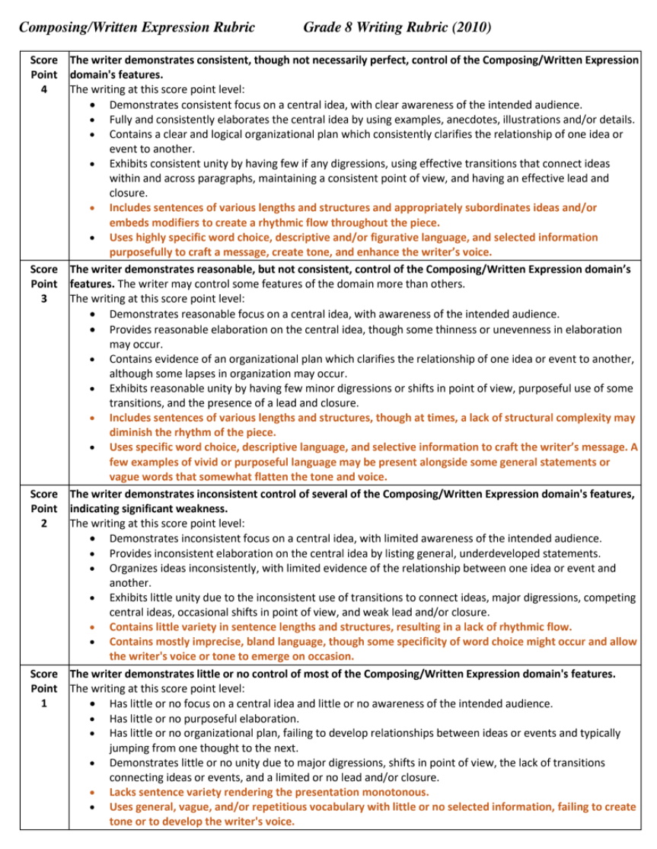
PERSUASIVE WRITING RUBRIC
A school-based team of teachers scored our students’ essays. These teachers were trained in calibrated scoring for the PBA, using the VDOE 8th Grade rubric for Composing and Written Expression, and Grammar, Usage, and Mechanics.

Slide 28
PRESENTATION OBJECTIVE 3
Discover ways to collaborate with teachers and support staff.

Slide 29
INSTRUCTIONAL TEAM
CLT
8th Grade English Classroom Teachers
SUPPORTING TEACHERS
Reading Specialist
Media Specialist
Special Education Teacher or Aide
English Learner Specialist
Advancing Learning Specialist
When we needed support, these people provided help in Google Meets, breakout rooms for small groups, and content differentiation, such as reading guides, vocabulary support, language accessibility, and extension opportunities.

Slide 30
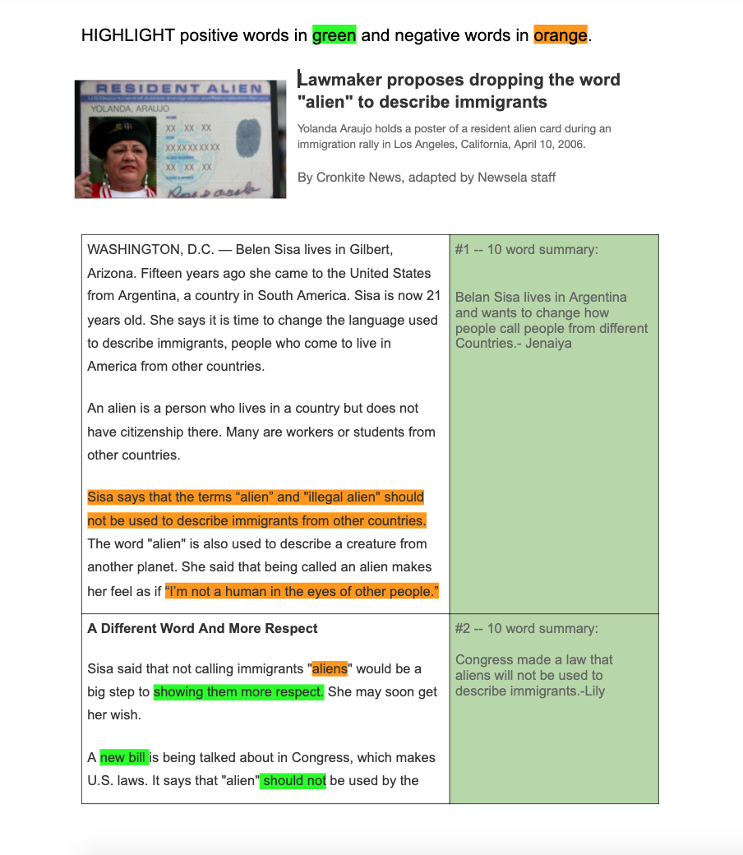
READING GUIDE - Instructional Level for SWD
Students read some texts in a reading guide format. They discussed each section and highlighted text evidence that supported the positive or negative use of words.
Then, they summarized each section in 10 words or less. The highlighted text became the base for their responses in their Evidence Trackers.

Slide 31
PARTNER READING - On Grade Level or Instructional Level
Partner reading is an established strategy at Skyline for attacking grade-level text.
Reading partners followed the directions on this sticky note as they took turns reading, summarizing, and highlighting.

Slide 32
GROUP READING - On Grade Level
Students participated in group reading to engage with a text and each other. As students read, they highlighted phrases that stood out (unfamiliar, interesting words, main ideas) to stay on track.
The highlighted words became part of the students’ responses on their Evidence Trackers.

Slide 33
FRONTLOADING STRATEGY for ELs
Our EL teacher used support time with EL students to frontload vocabulary and connect with real-world examples.
Other frontloading options included web-based applications such as Pear Deck, Quizlet, Blooket, and Kahoot.

Slide 34
REFLECTIONS

Slide 35
Student Levels of Success
Connections (8.6d, 8.6e)
Timely teacher feedback on the Evidence Tracker led to deeper connections throughout the unit.
Perspectives (8.6k, 8.6l)
Students showed greater engagement in their persuasive writing and use of other viewpoints in their evidence.
Persuasion (8.7a, 8.7c, 8.7f, 8.7g, 8.7h, 8.7j)
Students were able to support strong opinions with ample evidence in an organized way.

Slide 36
Levels of Success in the Words of Students
“I would recommend adding more of the text choices that had a ‘words don’t matter’ point of view.”
“I liked all the choices we had and the diversity of sources.”
“I liked writing a rebuttal, because it’s an almost foolproof persuasion.”
“I was actually interested in this.”
“I liked the Evidence Tracker because we could look back at what we did and support our words.”
“I was able to learn about why people care so much about the words others say.”

Slide 37
ADAPTATIONS
Grade Levels
Choose appropriate sources and summatives.
Time Frame
Tailor this unit to the time you have available.
In-person or Virtual
Build comfort using digital interaction.
Persuasive Options
Debate topics or sources with Socratic Seminars or Philosophical Chairs.
Writing Instruction
Align this unit to your curriculum map.

Slide 38
Resources We Used
Commonlit (stories and poems): “The Bet”, “Mother to Son”, “A Retrieved Reformation”, “The Stolen Party”, “The Talking Skull”, “Ain’t I a Woman”
TED Talks/Speeches: Amanda Gorman, Chimamanda Ngozi Adichie, Greta Thunberg, Emtithal Mahmoud, Brad Meltzer, John Lewis
Podcasts (NPR): Howard White, Tarak McLain, William Wissemann, Robert Fisher, Bianca Brooks
Viewables: Animated Short Films, PSAs, graffiti, murals, billboards, “The Power of Words” (YouTube)
Nonfiction articles: We are able to use Newsela for many articles. Other online news sources are available.

Slide 39
THANKS!
Any questions? You can find us at...
Angela McClure: amcclure@harrisonburg.k12.va.us
Jeanine Maddox: jmaddox@harrisonburg.k12.va.us
“Using our words is one of our biggest superpowers.” ~ Ava, 8th grade student

Slide 40
Disclaimer
Reference within this presentation to any specific commercial or non-commercial product, process, or service by trade name, trademark, manufacturer or otherwise does not constitute or imply an endorsement, recommendation, or favoring by the Virginia Department of Education.

