Slide 1
Developing Thinking in Upper Elementary Grades: Combining the Persuasive Mode of Writing with Iterative Reading, Research, and Discussion
VDOE Standards of Learning Institutes, 2021
Tamara T. Williams, NBCT, Division Level Reading Coach, Grades 4-8
Alison Mosko, Grade 5 Writing Instructor
Tazewell County Public Schools

Slide 2
Agenda
Welcome
Section 1
Objectives
Overview of C3WP
Background
Vocabulary and Terms
Virginia Standards of Learning
Reading and Writing
Section 2
Research to Practice: Implementation

Slide 3
Research and Background
Section 1

Slide 4
Objectives
Demonstrate the use of persuasive writing for the following purposes:
Using text sets that incorporate multiple perspectives on a single topic
Incorporating iterative reading and writing practices
Utilizing organizational structures that are not based on formulas
Incorporating formative assessment opportunities
Integrating the Virginia Standards of Learning in Communication, Reading, Writing, and Research

Slide 5
Background (1 of 2)
What is the College, Career, and Community Writer’s Program?
C3WP is a professional development opportunity for elementary, middle, and high school teachers with a primary focus of supporting the instruction of evidence-based argument writing from nonfiction sources. By utilizing a spectrum of practices including routine argument writing, text based mini-units, researched arguments, and formative assessment practices, students are able to develop skills in source-based argument writing which in turn leads to civic and community engagement.
The National Writing Project with the support of the United States Department of Education’s Investment in Innovation (i3) grants has engaged in research on this initiative since 2013.

Slide 6
Background (2 of 2)
In order to support instruction of the 2017 English Standards of Learning (SOL), this PowerPoint presentation has been developed to provide support for teachers to create and implement authentic writing cycles that are engaging to students. Using authentic text sets is an instructional tool that can help build 21st Century skills. Please refer to webinar slides 3 and 4: Assessment Supports 2020 - 2021
Some of the information used in this PowerPoint was gleaned from actual writing cycles that were completed during the 2018-2019 and 2020 -2021 school years.

Slide 7
Key Terms (1 of 3)
recursive writing : writing that is broken into steps that feed by process and can be revisited - prewriting, drafting, revising, and editing
iterative process: improving and shaping a piece of writing over time in a continuous cycle that eventually becomes the final project - Incorporating reading and discussion into the writing process allows new ideas to occur and connections are then made between those ideas.
claim: an opinion that is debatable and defensible
counterclaim: made in opposition to a claim

Slide 8
Key Terms (2 of 3)
credentials: makes experts believable - CRED: believe
evidence: helps prove your point and backs up your claim
commentary: comments that discuss the evidence and how it relates to the claim
text sets: a collection of texts chosen intentionally for use in a mini-unit

Slide 9
Key Terms (3 of 3)
Opinion Writing: supported by reasons that have further explanations - grades 3 and 4
Persuasive Writing: convincing your audience that your opinions have merit or are valid – grades 5, 6, 7, 8, 9, and 10
Argumentative Writing: presenting logical arguments to persuade the reader to agree with your viewpoint – grades 11 and 12
Curriculum Frameworks for the Standards of Learning Documents for English

Slide 10
Virginia Standards of Learning for English Writing (1 of 2)
Grade 3 Writing
3.8 The student will write in a variety of forms to include narrative, descriptive, opinion, and expository.
3.8 d. Use organizational strategies to writing according to writing type. (Opinion)
State a clear opinion
Provide multiple facts using specific vocabulary as reasons to support
Provide a conclusion
Grade 4 Writing
4.7 The student will write in a variety of forms to include narrative, descriptive, opinion, and expository.
4.7 e. Recognize different forms of writing have different patterns of organization. (Opinion)
State a clear opinion
Provide multiple facts as reasons for support
Provide a conclusion

Slide 11
Virginia Standards of Learning for English Writing (2 of 2)
Grade 5 Writing
5.7 f. Recognize different forms of writing have different patterns of organization, including story structure for narrative writing. (Persuasive)
Introduce a position
Provide evidence to support the position
Provide points for the opposite side and argue against them
Grade 5 Writing (Continued)
5.7 d. Introduce and develop a topic, incorporating evidence and supporting details that elaborate the main idea.
Select specific information to guide readers more purposefully through the piece
Include details that elaborate the main idea

Slide 12
Virginia Standards of Learning for English Research (1 of 2)
Grade 3 Research
3.10 Demonstrate comprehension of information resources to research a topic and complete a research product.
3.10 a. Construct questions about the topic
3.10 b. Access appropriate resources
3.10 c Collect and organize information
3.10 d Evaluate the relevance of the information
Grade 4 Research
4.9 The student will demonstrate comprehension of information resources to create a research project.
4.9 a. Construct questions about a topic
4.9 b Collect and Organize Information
4.9 c Evaluate the relevance and reliability of information
4.9 d Give credit to sources used in research

Slide 13
Virginia Standards of Learning for English Research (2 of 2)
Grade 5 Research
5.9 The student will find, evaluate, and select appropriate resources to create a research product
5.9 a Construct a question about a topic
5.9 b Collect and organize information from multiple sources
Grade 5 Research (Continued)
5.9 c Evaluate the reliability, relevance, and creditability of information
5.9 d Give credit to sources used in research

Slide 14
Virginia Standards of Learning for English Oral Language
Communication and Multimodal Literacies
Multimodal presentations (e.g., written language, moving images, music, audio, presentation technologies, movement)
Grades 3,4, and 5 - The student will use effective communication skills in a variety of settings.

Slide 15
Virginia Standards of Learning for English Reading (1 of 4)
Grade 3 Reading
3.6 Read and demonstrate comprehension of nonfiction texts
Identify author’s purpose for writing
Use prior and background knowledge as context for new learning
Preview and use text features
Ask and answer questions about what is read, using the text for support
Draw conclusions using the text for support
Summarize information found in nonfiction texts
Identify the main idea
Identify supporting details

Slide 16
Virginia Standards of Learning for English Reading (2 of 4)
Grade 4 Reading
4.6 Read and demonstrate comprehension of nonfiction texts
Use text features
Explain author’s purpose
Identify the main idea
Summarize supporting details
Draw conclusions/Make Inferences using textual information as support
Identify cause and effect relationships
Distinguish between fact and opinion

Slide 17
Virginia Standards of Learning for English Reading (3 of 4)
Grade 5 Reading
5.6 Read and demonstrate comprehension of nonfiction texts
Use text features such as type, headings, and graphics, to predict and categorize information.
Skim materials to develop a general overview of content and to locate specific information Identify the main idea
Summarize supporting details
Identify organizational pattern(s)

Slide 18
Virginia Standards of Learning for English Reading (3 of 4)
Grade 5 Reading (Continued)
5.6 Read and demonstrate comprehension of nonfiction texts
Identify transitional words and phrases that signal an author’s organizational pattern.
Locate information to support opinions, inferences, and conclusions from the text.
Identify cause and effect relationships
Differentiate between fact and opinion

Slide 19
Virginia Standards of Learning for English Reading (4 of 4)
Grade 5 Reading
5.6 Read and demonstrate comprehension of nonfiction texts
j. Compare and contrast details and ideas within and between texts.
two accounts or perspectives of the same event or topic
understand that ideas and topics are presented differently by different authors
Curriculum Frameworks for the Standards of Learning Documents for English

Slide 20
The Reading and Writing Connection
How can writing help students be better readers?
Three ways that reading and writing are connected:
Reading and writing draw upon the same body of knowledge.
Reading and writing are communicative processes.
Reading and writing connect through combined use.
How Can We Take Advantage of Reading-Writing Relationships?
Shanahan on Literacy

Slide 21
Research to Practice
Section 2
Implementation
Creating a Persuasive Paper

Slide 22
Task
Creating a Persuasive Paper from a Text Set
Assignment
Whether or not you think zoos are an actual problem is really up to you. Are the animals thriving? Do they have enough space to meet their needs? Do zoos actually help endangered animals? Do zoos allow the general public to view animals that they might not ever get to see? Who benefits from zoos, the animals or the general public?
Write a paper that supports your position using textual evidence from your resources.

Slide 23
Generate Interest
Ask questions and probe for prior knowledge while gathering ideas.
Have you ever been to a zoo?
What do you know about zoos?
What are two positive reasons for keeping animals in zoos?
What are two negative reasons for keeping animals in zoos?
Do you think animals should be kept in zoos?
Students can use a writer’s notebook to track their thinking.
Turn and talk to a partner about why you feel so strongly about what you wrote.

Slide 24
Develop a Claim or Position
As students moves through the process, their claims or positions may change.
Use these Sentences to Help Students
I agree with ______ because ______.
I disagree with ______ because ______.
Others may say that, but I argue ______.
It may be true that ______ , however, ______.
It’s easy to think ______ but when you look at the facts ______.
No, because ______.
Yes, but ______.
I can see that ______; however, I disagree with ______ because ______.

Slide 25
Reading and Viewing for Text Sets and Media Pieces
Teacher Led
Teaching students how to break down complex text in order to both comprehend and locate evidence
Directed Reading Thinking Activity
Think Pair Share
Paired Reading
Jig Saw
Notice and Note
3-2-1 Summarizer
Close Reading
Audio
The purpose is to gradually release responsibility of reading to the students.
Independent Reading

Slide 26
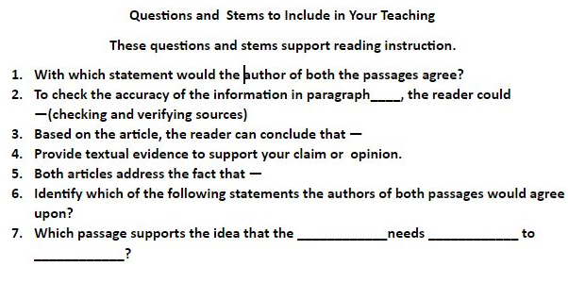
Questioning when Reading
Open and closed questions
Funnel questions
Probing questions

Slide 27
Class Discussions Before, During and After Reading
Discussing
Grand conversations
Build on other’s ideas
Clearly state thoughts, opinions, and ideas
Use evidence to support opinions and conclusions

Slide 28
Annotating
Annotate the Articles
Highlight, color-code, circle, or underline key vocabulary and important information in the articles
Make notations in margins of articles

Slide 29
Notetaking
Note Taking Ideas
Note catcher
Evidence vs. Opinion T-Chart

Slide 30
The Writing Process
Planning, Drafting, Revising, Editing, and Publishing
Utilizing the notes
Completing the graphic organizer
Incorporating the instructional rubric

Slide 31
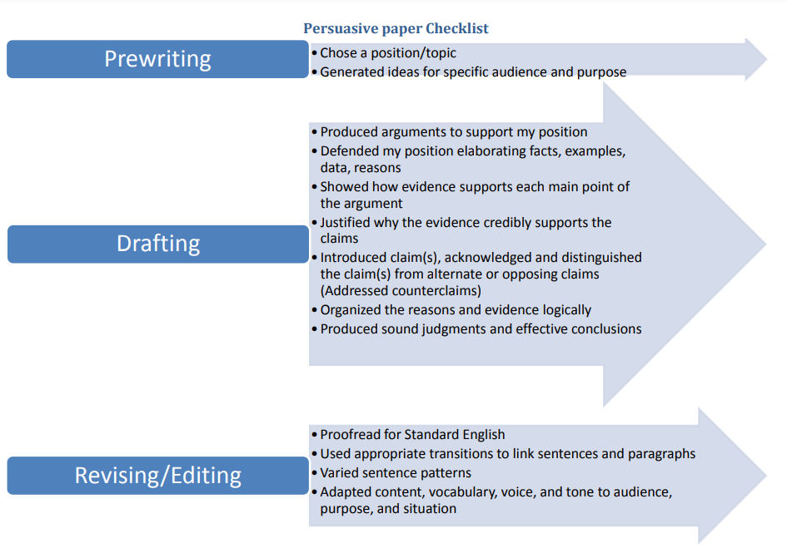
Persuasive Paper Checklist
English On-line Writing

Slide 32
Scoring Sites (1 of 2)
Scoring
To access Understand Scoring, follow the link provided in one of two places on the Virginia Department of Education’s website.

Slide 33
Scoring Sites (1 of 2)
Performance Assessments and Local Alternative Assessments
Grade 5 Writing Scoring Rubric

Slide 34
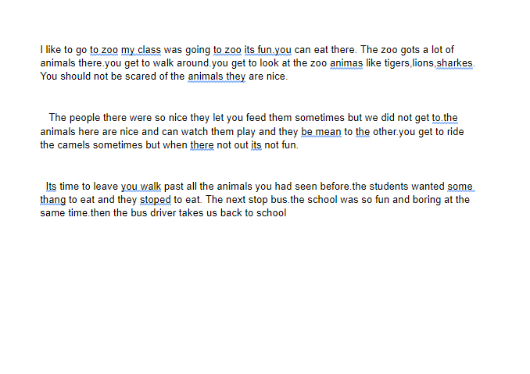
Score 1
Provides little/no unity,
elaboration of a central idea
Demonstrates little/no focus on a central idea. Lacks awareness of audience
Exhibits limited or no organization – disconnected from the central idea

Slide 35
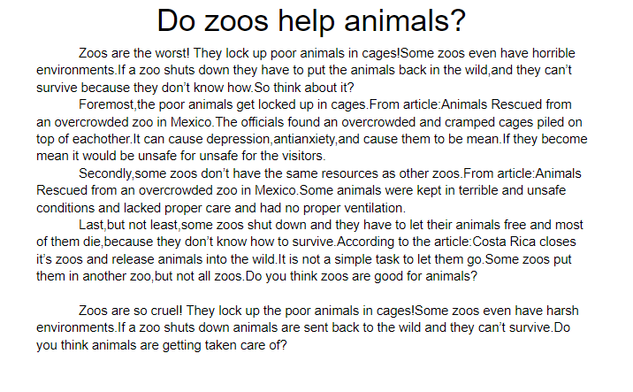
Score 2
Limited evidence of ideas to central theme.
Provides limited elaboration of central idea by repeating mostly relevant details
Word choice is inconsistent and distracting

Slide 36
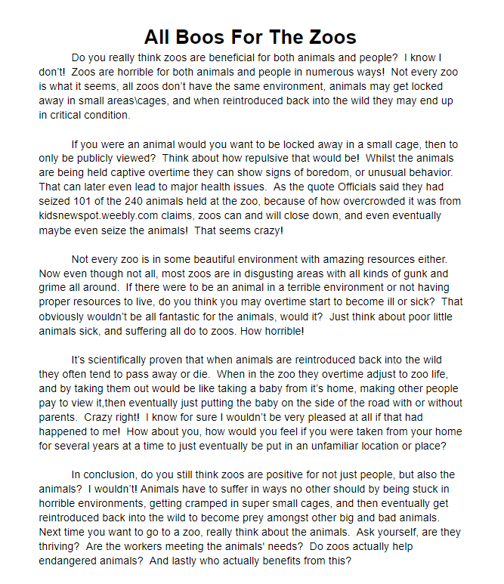
Score 3
Consistent focus on central idea and attempts to address audience/purpose
Elaborates the central idea by providing relevant/descriptive details
Organizes ideas in a logical manner

Slide 37
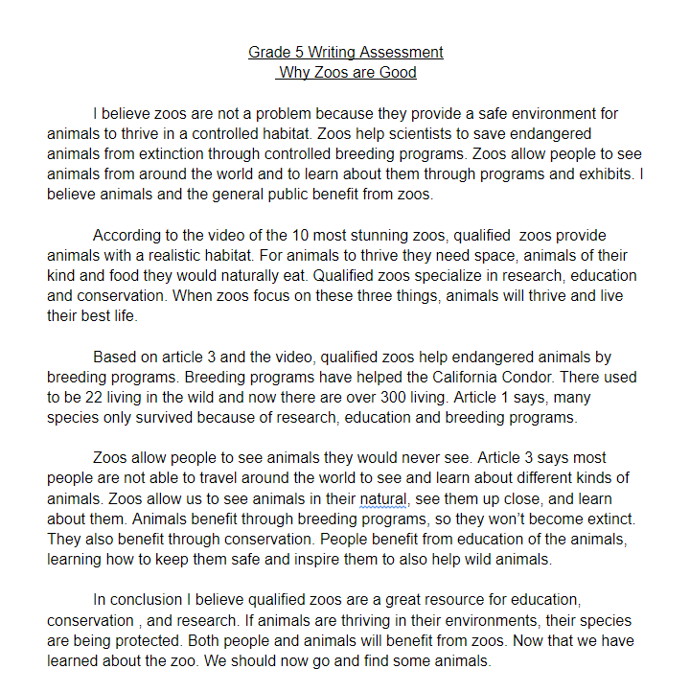
Score 4
Clear, consistent focus on theme
Fully organizes ideas and connects them to the theme
Fully develops and elaborates central idea with highly relevant or descriptive details

Slide 38
List of Website Resources for Text Sets
Library of Congress | https://www.loc.gov/
National Geographic | https://www.nationalgeographic.org/education/
Read Works | www.readworks.org
Library of Virginia | http://www.lva.virginia.gov/
Encyclopedia Virginia | http://encyclopediavirginia.org
VMHC History Explorer | https://www.virginiahistory.org/collections-and-resources/virginia-history-explorer
CommonLit | https://www.commonlit.org/
Read Write Think | http://www.readwritethink.org/
C3WP Upper Elementary | https://sites.google.com/nwp.org/c3wp/home
The Digital Library of Appalachia | https://dla.acaweb.org/digital/collection/Ferrum

Slide 39
Additional References
Burke, K. (1974). The philosophy of literary form (3rd ed.). University of California Press.
Harris, J. (2017). Rewriting: How to do things with texts. Utah State University Press.
National Writing Project. (2020) The College, Career, and Community Writers
Program. sites.google.com/nwp.org/c3wp/home/
Virginia Department of Education (2021) English, https://www.doe.virginia.gov/testing/sol/standards_docs/english/index.shtml
Virginia Department of Education (2021) Performance Assessments and Local Alternative Assessments, https://www.doe.virginia.gov/testing/local_assessments/index.shtml

Slide 40
Link for Persuasive Resources
https://drive.google.com/drive/folders/1kDXNrSZ80-dr99m1lIr6r-LxzsHTWtwW?usp=sharing

Slide 41
Contact Information
Tamara T. Williams – twilliams@tcpsva.org
Alison Mosko – amosko@tcpsva.org

Slide 42
Disclaimer
Reference within this presentation to any specific commercial or non-commercial product, process, or service by trade name, trademark, manufacturer or otherwise does not constitute or imply an endorsement, recommendation, or favoring by the Virginia Department of Education.

