Slide 1
VDOE Summer Institute
Grades 3 – 5
Getting the MAX out of Instruction
Teaching Exponentially

Slide 2
Teaching with Urgency-Getting the MAX out of Instruction
Exponential Teaching
Annette Conley, Jennifer Haws
Virginia Beach

Slide 3
Overview
This presentation will provide activities and lessons to meet the English SOLs for grades 3 – 5.
The activities and lessons will cover many SOLs to help MAXIMIZE instruction.
Our goals:
To provide engaging lessons that participants can easily use for exponential instruction
To provide effective strategies for teaching the English SOLS

Slide 4
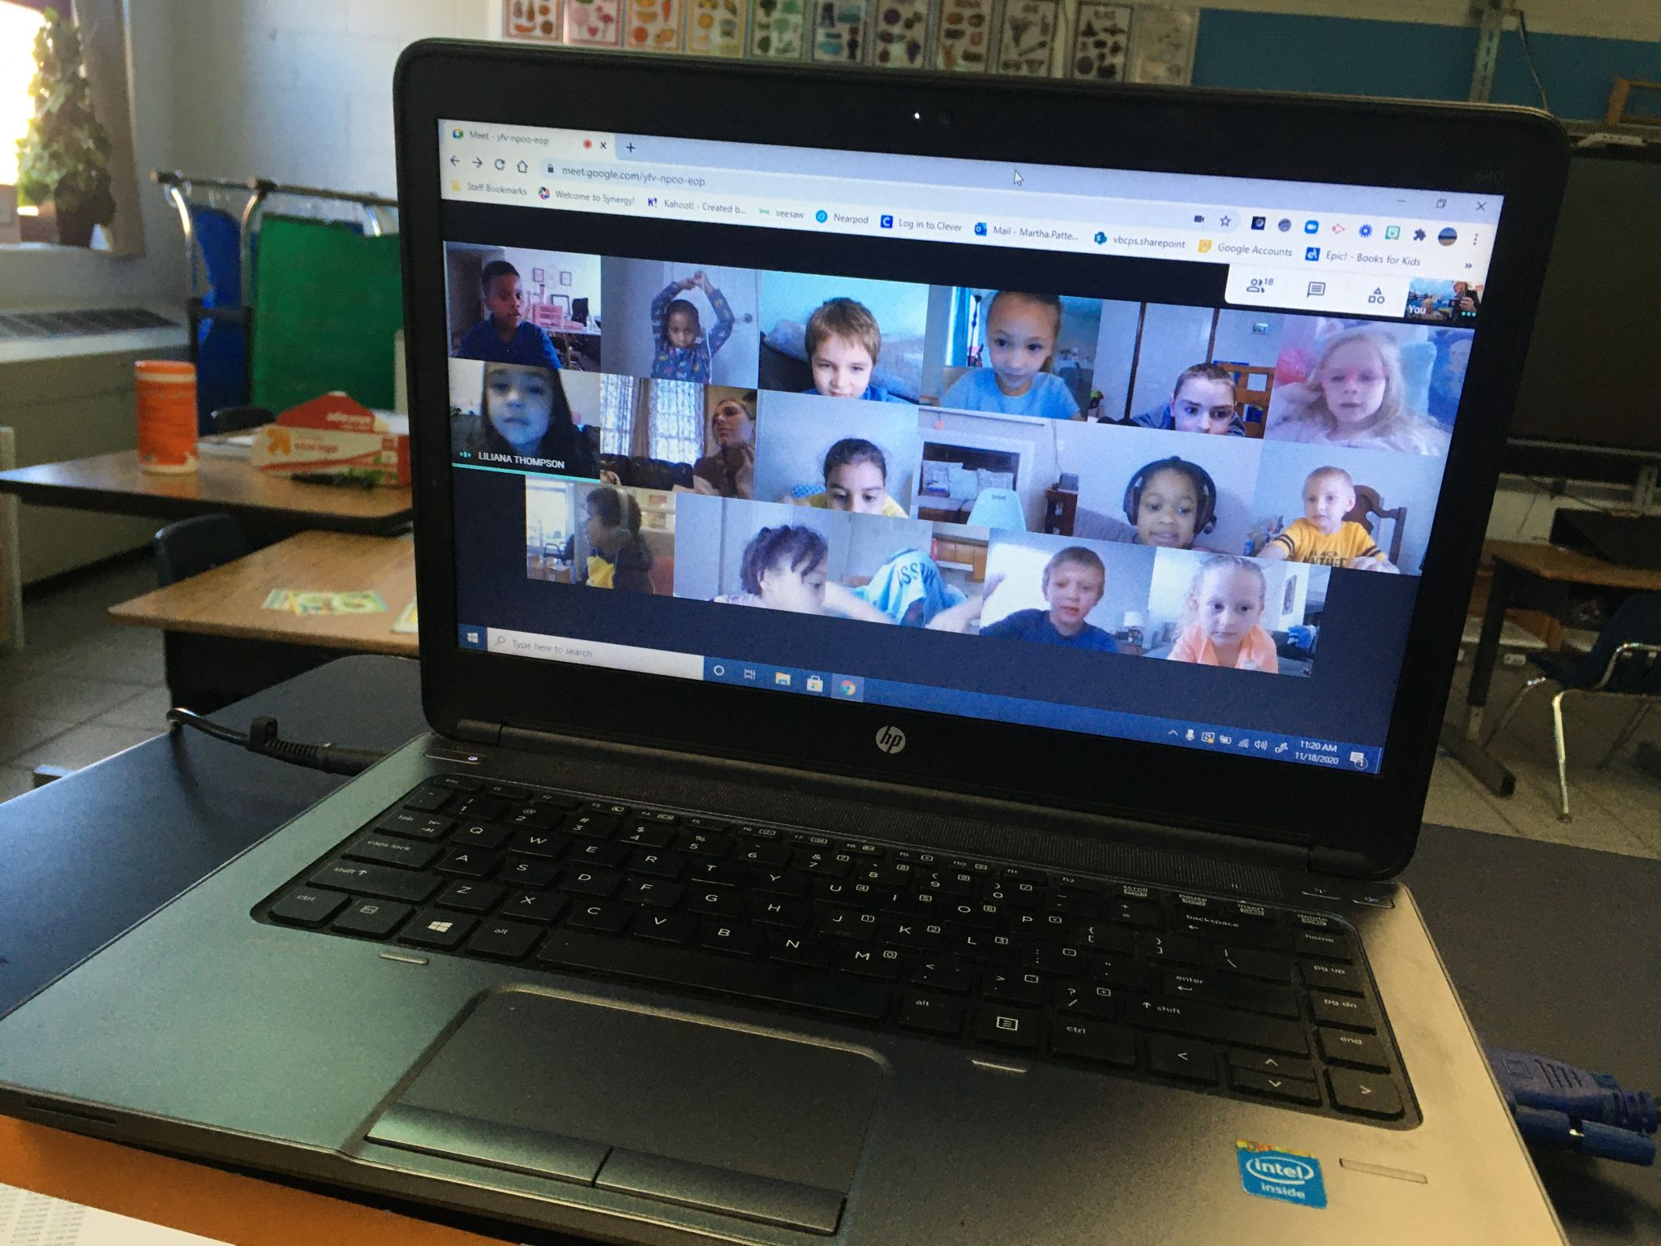
Exponential Teaching
Our WHY??
We watched students struggling this year
Balancing the needs of student SEL and learning
Missed instructional minutes
Students did learn! Need to capitalize on these successes/strategies.

Slide 5
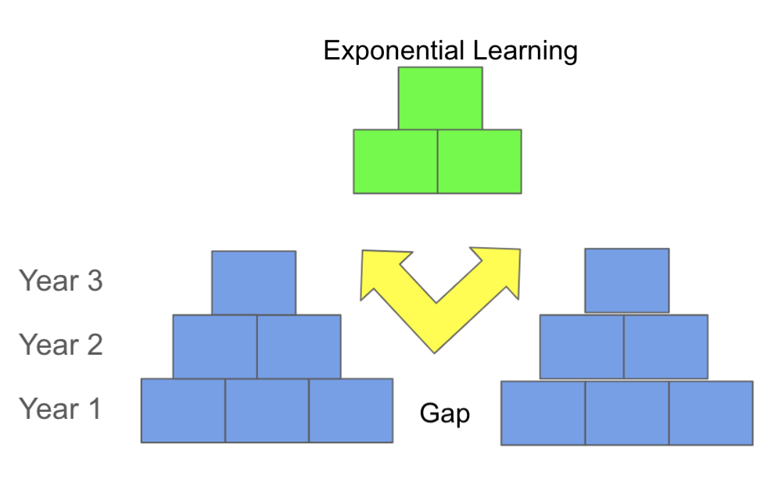
Exponential Learning - How to Get the MAX
Gaps grow exponentially! Learning must grow exponentially!

Slide 6
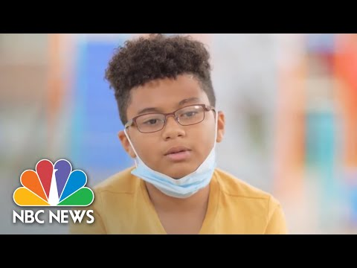
Exponential Teaching
The STUDENTS’
Why

Slide 7
Exponential Learning Starts with the Students
Student Agency is a “precious resource.” (Waite)
With ownership, students have control over learning variables.
Need to teach students to create goals around their learning.

Slide 8
Student Agency
Implications for us ALL
Have students set goals
Goal-Setting Action Steps:
Set goals
Act toward goals
Reflect on Goal Progress
Have students think of their own why?
Involve parents in the process

Slide 9
Teaching ² ⁼ Exponential Teaching
Exponential teaching is deliberate teaching
Leads to deeper learning.
Uses best practices
Pushes them into hyperdrive.
Requires student and teacher input

Slide 10
How to Teach Exponentially?
1. Learning Targets
Share the targets with students
Discuss grade-level expectations (How did the learning target expectations change from grade __ to grade __)?
Teach students to own their progress in relation to the target
Students need to commit to closing the gap (extra practice, better attention, asking questions, asking for help)

Slide 11
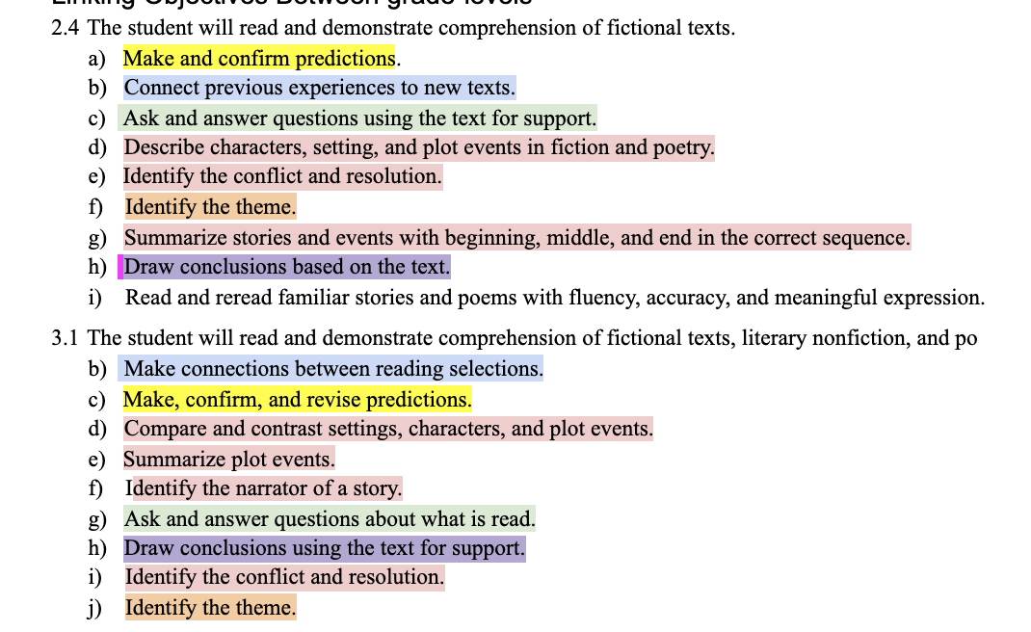
Link Grade-Level Expectations

Slide 12
How to Teach Exponentially
2. Combine Learning Objectives
Identify objectives that can be taught in combination
Use the same whole group texts/discussions but focus on multiple targets/objectives
Target critical objectives (main idea / summarizing / inferences)
Help students see how objectives relate

Slide 13
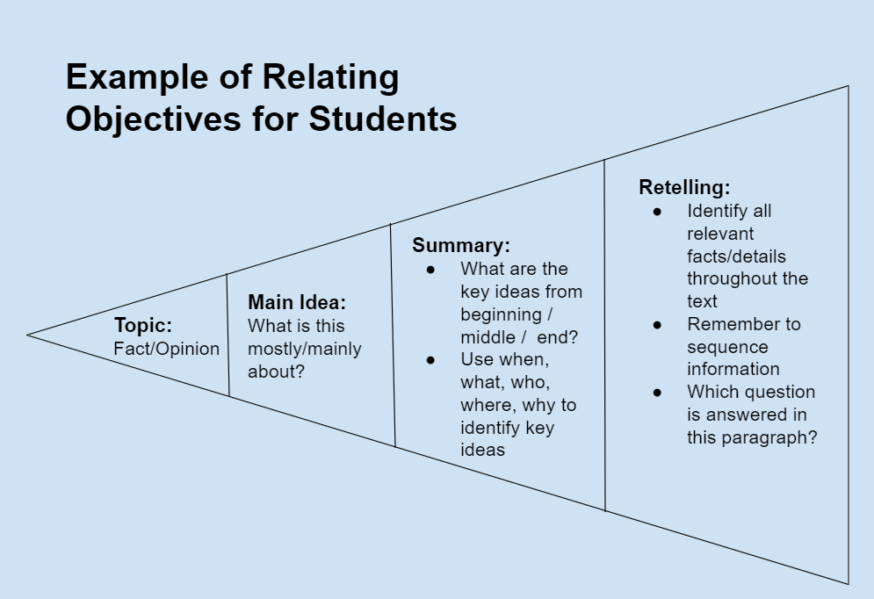
GO

Slide 14
Example: Komodo Dragons (ReadWorks)
You have probably heard or read at least one fairy tale with a dragon as a character. In these stories, dragons fly around breathing fire and frightening innocent people, until a brave knight comes along and kills the dragon. But there is no proof that these fairy tale dragons ever existed.
There is, however, one real dragon that does exist: the Komodo dragon. No, it does not breathe fire and it does not fly. It’s just a big reptile. They can be pretty mean. It’s rare, but they have attacked and even killed humans. So, be careful if you are ever traveling through Indonesia.
These dragons are named after the island of Komodo, which is part of Indonesia. They can be found on four or five other Indonesian islands, as well, but overall, they are pretty rare.
They prefer hot, dry places. They dig burrows two to three feet deep in the ground. Like most reptiles, they spend most of their time sleeping or simply relaxing.
A Komodo dragon can be as big, or bigger, than a crocodile. They weigh up to 150 pounds and can be over ten feet long from tail to head. The largest one on record weighed 370 pounds, or as much as about six third graders.
Like many reptiles, they can’t hear or see very well. Instead, they have a strong sense of smell. They do not use their nostrils to smell—they use their tongue! They can smell food several miles away if the wind is blowing in the right direction!
Speaking of food, Komodo dragons are carnivores, so they eat mainly meat. For the most part, they eat dead animals. But if there are no dead animals around, they hunt for food.
https://www.readworks.org/article/Interesting-Animals/2375ecde-244e-44e5-baa3-f8ba66df2120#!contentSection:020c4d62-d74e-421c-af2f-6ee7f7fcaa75/articleTab:content/

Slide 15
Model

Slide 16
Getting Started
To begin developing lessons that will help students grow exponentially, take a lesson that you’ve taught before and think of how to give it more power.

Slide 17
Teaching ²
Think of a lesson that you’ve taught before that you felt was successful.
Which SOL did you teach?
What other SOLS could have been incorporated into that lesson?
What could have made the lesson have more power?

Slide 18
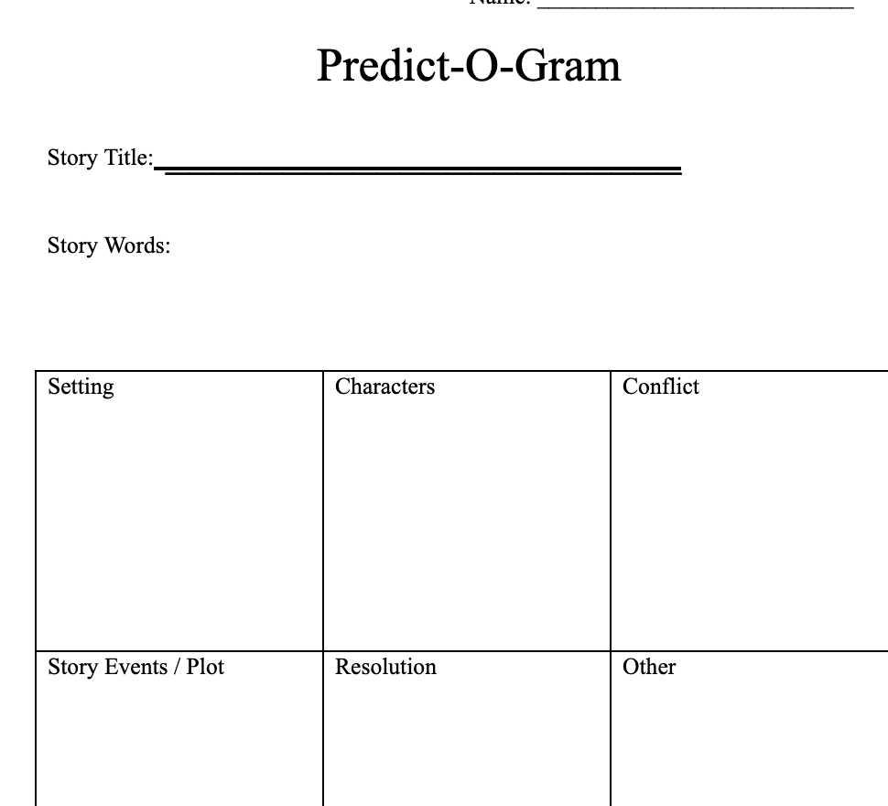
Teaching ² Whole Group Lesson Idea 1
Predict-O-Gram

Slide 19
Teaching² Predict-O-Gram:Related Objectives
The student will apply word-analysis skills when reading.
b) Decode regular multisyllabic words.
The student will expand vocabulary when reading.
Make, confirm, and revise predictions.
Compare and contrast settings, characters, and plot events.
Describe how the choice of language, setting, and characters contributes to the development of plot.
Summarize plot events using details from text.
Discuss the impact of setting on plot development.
Describe character development.

Slide 20
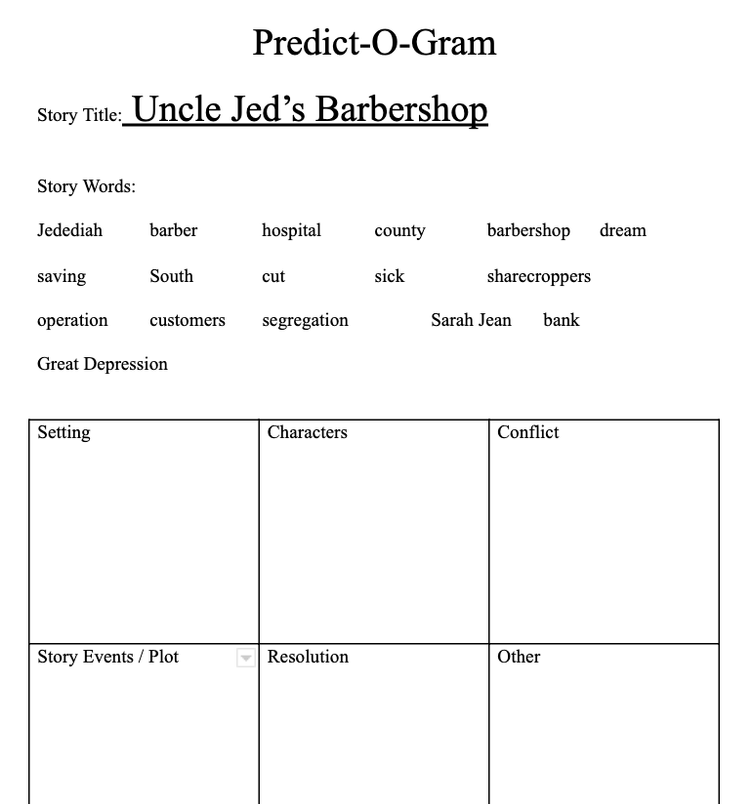
Teaching ² Predict-O-Gram Lesson 1
Prediction Day 1 of 2
Select six to eight words from the text you will be reading
Select words that connect to the characters, setting, and plot
Display one word at a time, ask the students how to pronounce the word, how many syllables the word has, what kinds of syllables they find in the word, and how to chunk the word into parts
Think of it as an abbreviated word study lesson with each word
Discuss word meanings, if necessary
Display a simple story map - character, setting, conflict, resolution
After each word has been taught and displayed, discuss with the students where they think the words would fit best on the simple story map
Place two or three of the words together, and then have students place the other words on their own or with a partner.
Notes:
Draw story map on white board

Slide 21
Teaching ² Predict-O-Gram Lesson 2
Prediction Day 2 of 2
Ask students to use the simple story map that they created as you read to confirm their predictions
Read the text with or to the students, stopping occasionally to allow students to check their story maps and to discuss the words that they placed
After reading, review all of the words that were placed
In grades four and five, focus an after reading discussion on setting and character development instead of confirming predictions

Slide 22
Teaching ² Other Whole Group Lesson Ideas
Use this lesson framework in nonfiction
Select six to eight words from the text you will be reading
Select words from the text features
Display and teach the words doing the abbreviated word study process
Read the text to or with the students and stop occasionally to focus on the words that were taught
Ask students to explain why those words are important to the text
Use the text to teach other SOLS like cause and effect and fact and opinion
Use this framework to teach homophones, synonyms and vocabulary from content
If vocabulary is the focus, add the Frayer Model to the lesson after the word study portion
Notes:
Draw Frayer model on White board

Slide 23
Teaching ² MORE Whole Group Lessons
Relate Reading and Writing objectives to maximize instructional learning and provide application of Reading skills
Favorite Activity! Pull from a bag or cup of topics
Author’s purpose
Fact and opinion
Main idea and details
Genres
?
Sample Topic: Pets
Author’s Purpose - Inform about…
Author’s Purpose - Persuade someone to purchase a specific pet
Share a fact or opinion about cows
Notes:
Draw Frayer model on White board

Slide 24
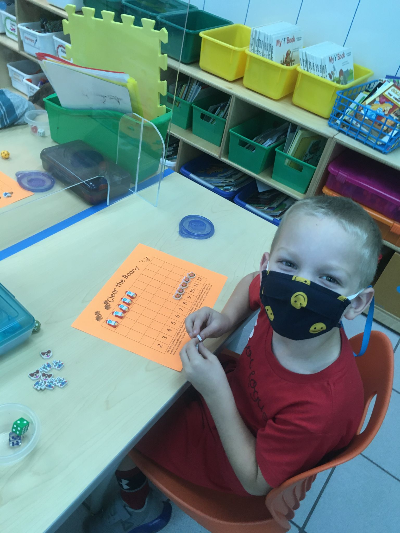
Teaching ² Transitions
Make the most of transition times!
Lining up Activities
List a fact from nonfiction
Share something about the setting of the story
Share something about the characters in the story
Share the conflict in the story
Share a synonym for bad
Share an antonym for tall
Notes:
Draw Frayer model on White board

Slide 25
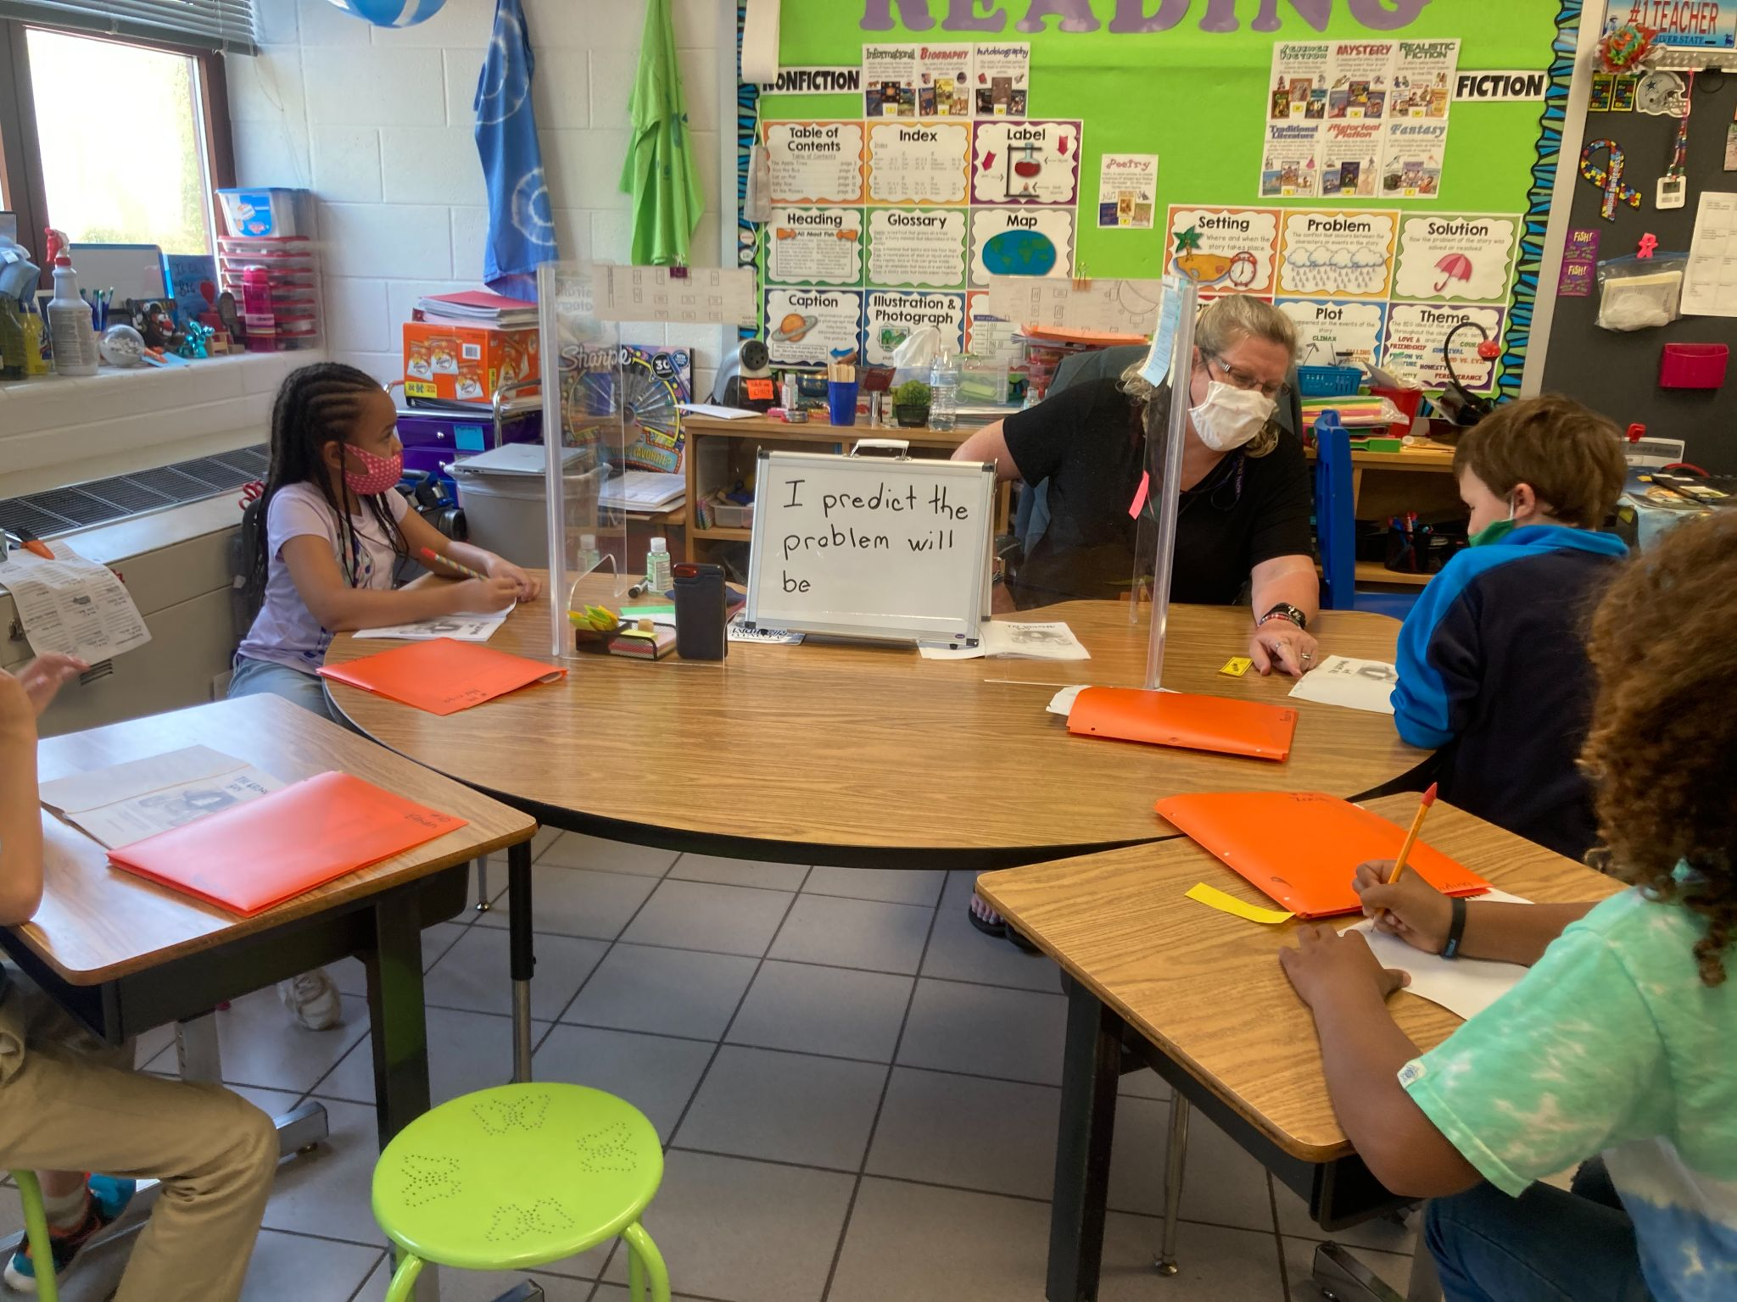
Teaching ² LA Small Groups
Remember to establish engagement right away!
Oral games
sound chain
last first
make one change
Word parts on post-its
Riddle of the day
Puzzle of the day

Slide 26
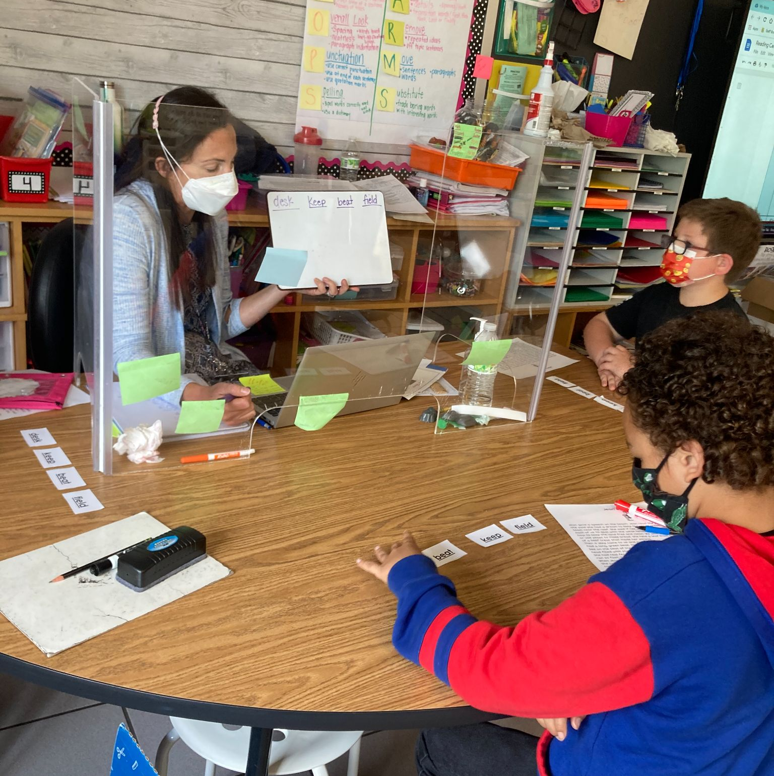
Teaching ² Small Group Structure
Structure – keep it the same, and they know what to expect!
Every day -
Phonemic Awareness - Orally
Phonics - Written
Text
Writing

Slide 27
Teaching ² Small Group Lessons 1 of 4
Day 1
Phonemic Awareness - Orally - Push or tap sounds
Phonics - Written - Orthographic Mapping - draw lines and write the words that were tapped, Introduce pattern
Text - one or two sentence decodable
Writing - dictated words

Slide 28
Teaching ² Small Group Lessons 2 of 4
Day 2
Phonemic Awareness - Orally - Push or tap sounds
Phonics - Written - Written sound chain
Text - paragraph of decodable, highlight words
Writing - dictated sentence

Slide 29
Teaching ² Small Group Lessons 3 of 4
Day 3
Phonemic Awareness - Orally - Push or tap sounds
Phonics - Written - guess the word
Text - grade level text
Writing - write about text - fiction - write about characters, non-fiction - write facts

Slide 30
Teaching ² Small Group Lessons 4 of 4
Day 4
Phonemic Awareness - Orally - Push or tap sounds
Phonics - Written - build a man
Text - grade level text - ask questions
Writing - silly sentences

Slide 31
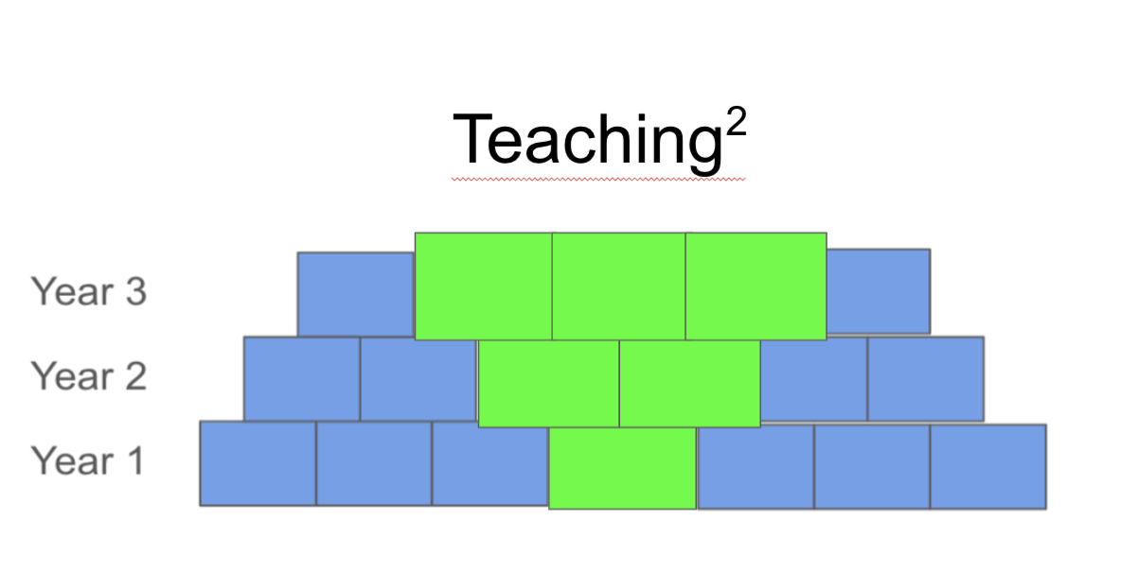
Exponential Learning = Teaching²
Student ownership
Student goal setting
Combine standards
Combine word study with comprehension
Maximize every minute
Look for opportunities every day

Slide 32
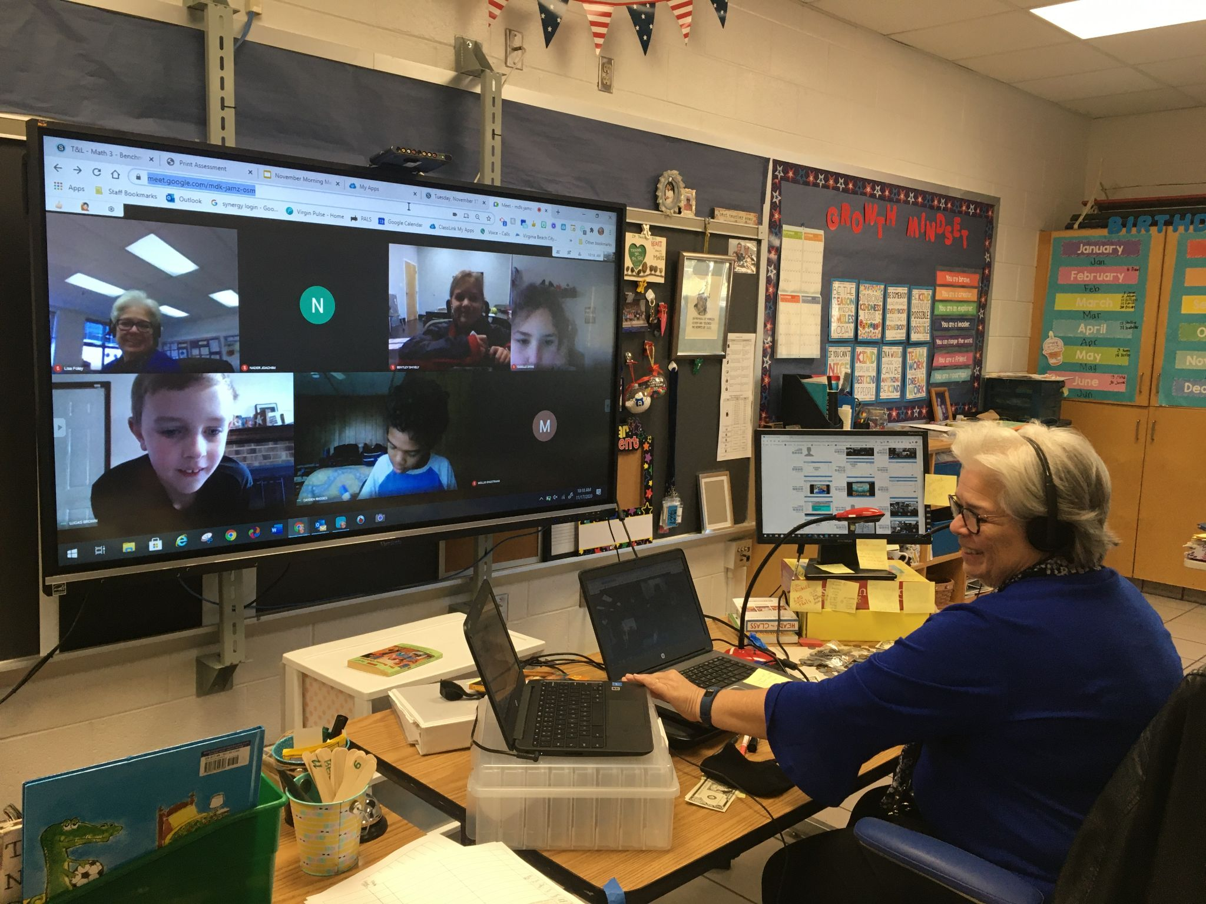
It’s all worth it! Your students will grow exponentially!
Annette Conley amconley@vbschools.com
Jennifer Haw jennifer.haws@vbschools.com

Slide 33
Resources
https://www.doe.virginia.gov/teaching/performance_evaluation/teacher/training_phase1/materials/part_4_student_achievement.ppt
Waite, C. (2020, June 11). How Student Agency Can Ease the Pain of Remote Learning and Teaching - EdSurge News. EdSurge. https://www.edsurge.com/news/2020-06-11-how-student-agency-can-ease-the-pain-of-remote-learning-and-teaching.
“Students Voice Opinions on Remote Learning” https://www.youtube.com/watch?v=8VZUpVZGpeE&t=3s

Slide 34
Disclaimer
Reference within this presentation to any specific commercial or non-commercial product, process, or service by trade name, trademark, manufacturer or otherwise does not constitute or imply an endorsement, recommendation, or favoring by the Virginia Department of Education.

