Slide 1
Integrating Interdisciplinary Content into Everyday Literacy Experiences
Angela Brandt, Reading Specialist
Noreen Ingram, Instructional Designer
Chesterfield County Public Schools

Slide 2
About Us
Noreen Ingram, MAT
Instructional Designer
Jacobs Road Elementary
Chesterfield County Public Schools
Angela Brandt, M.Ed.
Reading Specialist
Jacobs Road Elementary
Chesterfield County Public Schools

Slide 3
Overview
These are are the questions we will answer during this presentation:
Why is it important to integrate interdisciplinary content into reading instruction?
How can we give students an opportunity to apply reading skills in authentic learning experiences?
What is an example of a specific lesson and accompanying project to accomplish that goal?

Slide 4
The “Why”
Students need strong reading skills in order to access information in all content areas. If students are not given opportunities to apply reading strategies during authentic learning tasks, they will not gain the critical thinking skills needed to make connections while reading and build their understanding. Employing an interdisciplinary approach to text provides students with the practice necessary to become functional readers in the future.

Slide 5
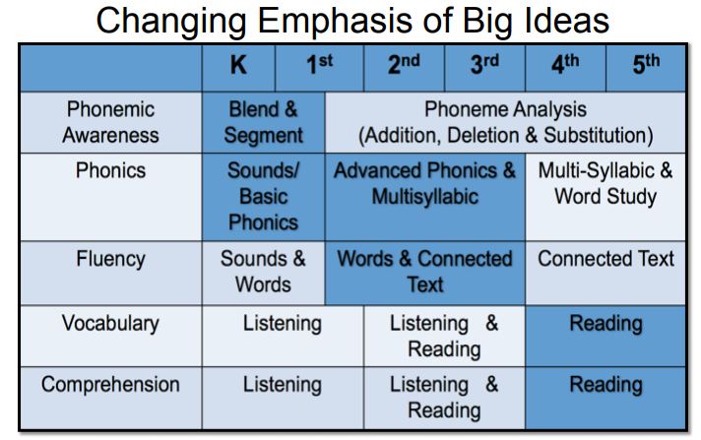
How does the emphasis on different reading skills change across grade levels?
As students move beyond second grade, the instructional focus shifts from phonics and phonemic awareness to comprehension; however, all of these skills are necessary to become a well-rounded reader.
Reference: Whitmore, T. & Huff, C. (2017-2018). Strengthening Reading [Powerpoint Presentation]. Michigan’s Integrated Behavior and Learning Support Initiative.
Notes:
Is it still important to teach phonics and phonemic awareness in grades 3-5?
Does that mean we don’t teach comprehension in K-2?
K-2 students are listening to text and answering comprehension and 3-5 students are reading and answering comprehension questions.
3-5 students should be using phonics and phonemic awareness skills in context while gleaning information from text being read.,
Need to know where we came from and where we are going

Slide 6
Reading is more than mechanics.
Reading is like riding a bike. A rider must balance, pedal, and steer at the same time. When reading, students need to understand phonics, decode, construct meaning and draw conclusions simultaneously.
Reading instruction cannot only focus on skills in isolation. Students need opportunities to practice synthesizing all of their reading skills to form a deeper understanding and use what they read to make connections. Students need to be able to apply what they read to real world scenarios.

Slide 7
Why is it important to integrate interdisciplinary content into reading instruction?
Provides opportunities for critical thinking
Sets an authentic purpose
Builds background knowledge
Strengthens content vocabulary
Makes reading meaningful
Engages students in text
Reinforces transferable skills
Supports content knowledge while honing reading skills
Helps students make connections

Slide 8
How can we give students an opportunity to apply reading skills in authentic learning experiences?
Purposeful pairing of content areas with reading skills
Examples:
Reading Skill: | Paired Content:
4.5a Character Analysis | VS.5b, VS.6ab, VS.9d Historical figures
4.5f Conflict and Resolution | VS.5 American Revolution
4.6c, 4.6d Main Idea and Details | 4.5 Planets
4.6f Cause and Effect | 4.4 Weather
Notes:
ADD SOL NUMBERS

Slide 9
Teaching Strategies to Support Interdisciplinary Learning
Summarizing/Paraphrasing
Think Alouds
Graphic Organizers
Independent Reading Activities
Close Reads
Genius Hour
Project Based Learning

Slide 10
Nonfiction Text Features Science Project

Slide 11
Nonfiction Text Features Science Project Overview
Students will be given text focused on a science standard (plants). The text they receive will not have any text features. They will have to answer this question: How can the author make this text more organized and easier to understand? Guide students to the idea that text features are needed. Students will then create the text features using the content from the given text.

Slide 12
Primary Objectives Reinforced
Reading 4.6 The student will read and demonstrate comprehension of nonfiction texts.
a. Use text features such as type, headings, and graphics to predict and categorize
Science 4.2 The student will investigate and understand that plants and animals have structures that distinguish them from one another and play vital roles in their ability to survive. Key ideas include
a. the survival of plants and animals depends on photosynthesis;
b. plants and animals have different structures and processes for obtaining energy;

Slide 13
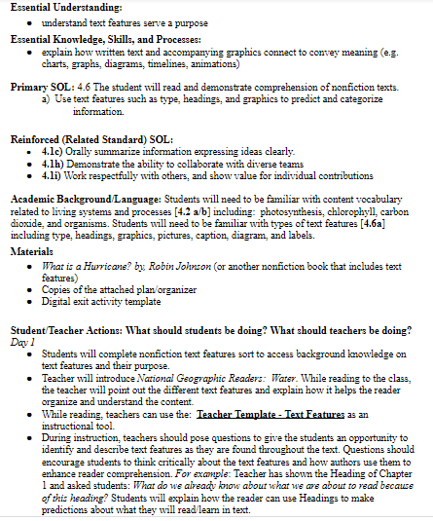
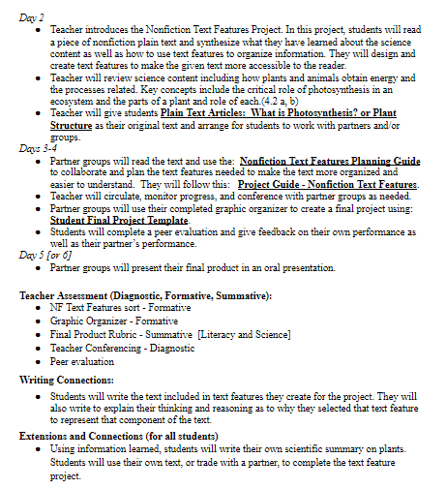
Instructional Plan

Slide 14
Activate Background Knowledge
Students will complete a text feature sort so the teacher can formatively assess their understanding of text features and the purpose of each.
This project is meant to be done after both the plant unit and the text features have been taught.

Slide 15
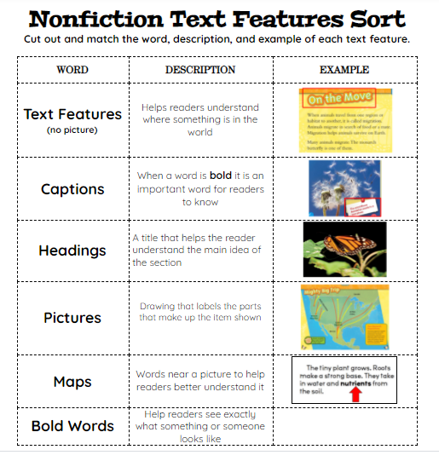
Text Features Sort
Notes:
Angie

Slide 16
Mentor Text
Teacher will introduce What is a Hurricane? By Robin Johnson. While reading to the class, the teacher will point out the different text features and explain how each helps the reader organize and understand the content.
Reference: Johnson, R. (2016). What is a Hurricane? Crabtree Publishing Company.

Slide 17
During Instruction
While reading, teachers can use the: Teacher Template - Text Features as an instructional tool. During instruction, teachers should pose questions to give the students an opportunity to identify and describe text features as they are found throughout the text. Questions should encourage students to think critically about the text features and how authors use them to enhance reader comprehension. For example: Teacher has shown the Heading of Chapter 1 and asked students: What do we already know about what we are about to read because of this heading? Students will explain how the reader can use Headings to make predictions about what they will read/learn in text.

Slide 18
Starting the Project
Teacher will review science content including how plants and animals obtain energy and the processes related. Key concepts include the critical role of photosynthesis in an ecosystem and the parts of a plant and role of each.(4.2 a, b)
Teacher introduces the Nonfiction Text Features Science Project to the students.
Teacher will give students an article to use as their original text and arrange for students to work with partners and/or groups.

Slide 19
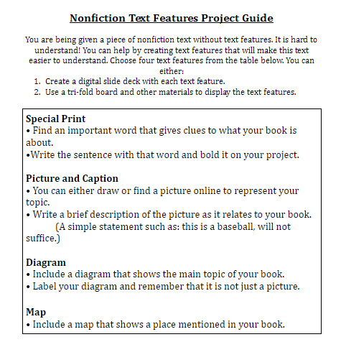
Project Guide

Slide 20
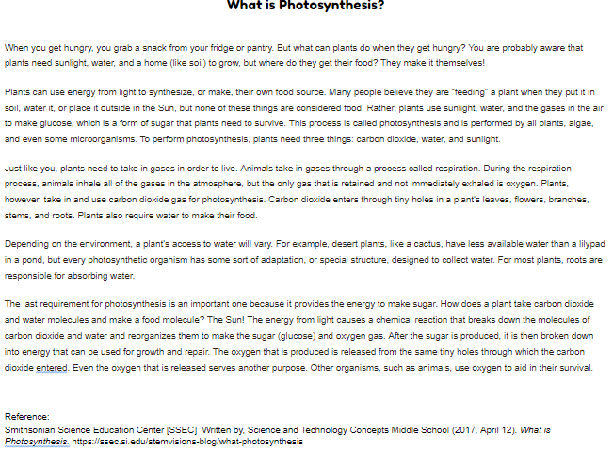
Plain Text (1 of 2)

Slide 21
Plain Text (2 of 2)

Slide 22
Getting to Work
Partner groups will read the text and use the Nonfiction Text Features Planning Guide to collaborate and plan the text features needed to make the plain text more organized and easier to understand. They will follow this Project Guide - Nonfiction Text Features.
Teacher will circulate, monitor progress, and conference with partner groups as needed.
Partner groups will use their completed graphic organizer to create a final project using: Student Final Project Template.

Slide 23
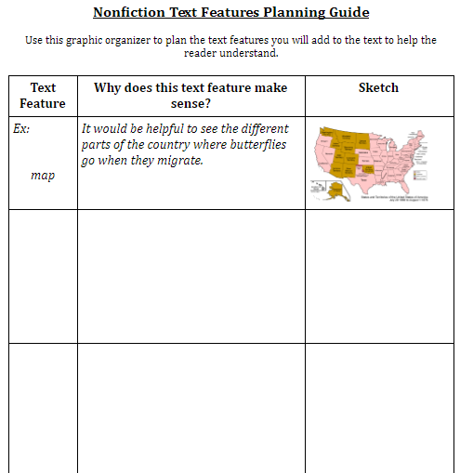
Planning Guide

Slide 24
Student Digital Product

Slide 25
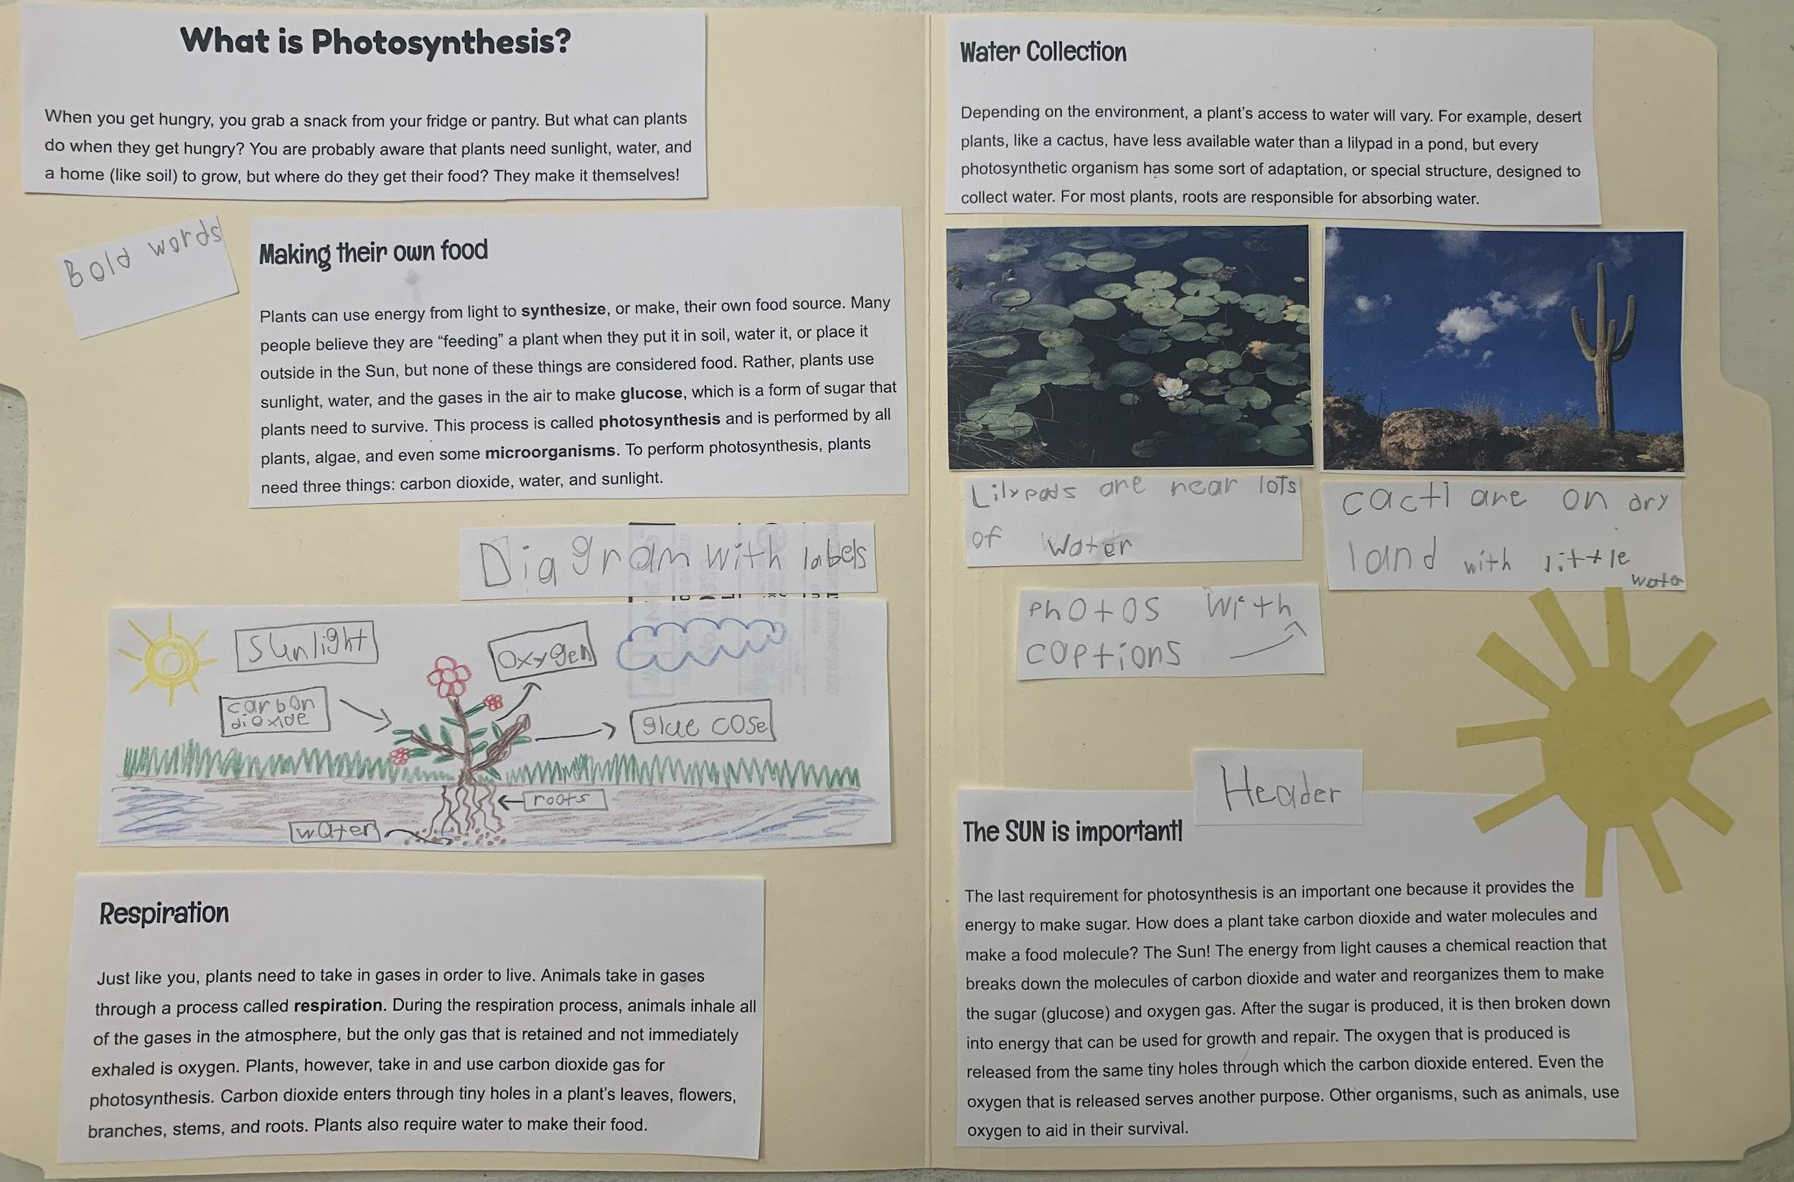
Example of a Student Non-Digital Product

Slide 26
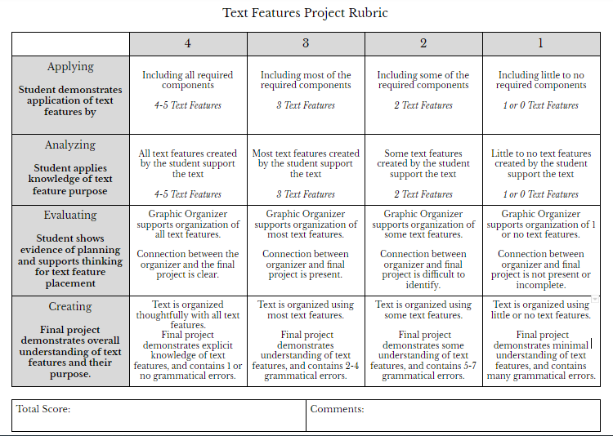
Rubric

Slide 27
Conclusion
At the conclusion of the project, partner groups will present their final product in an oral presentation.
Students will complete a peer evaluation as well as a self evaluation. They will give feedback on their own performance as well as their partner’s performance. (4.1 h, i)

Slide 28
Adapting the Project
This project could be adapted to address many other standards particularly in science and history.
It could be employed as a quarterly project to enhance student understanding and give more opportunity for application of reading skills across content areas.
Ex: In Quarter 1, the Text Feature Project could be used to review the plant unit in science. In Quarter 2, the Text Feature Project could be used to review the Civil War unit in history.

Slide 29
Continuing Interdisciplinary Studies
This project could serve as a framework for additional projects you could design to reinforce other foundational literacy skills in the reading curriculum while reviewing other content area information.
The project should be repeatable so content area text can be substituted to meet the instructional needs of your students and curriculum.
Future project ideas include Character Analysis, Conflict and Resolution, Main Idea and Supporting Details, Cause and Effect.

Slide 30
Contact Information
Noreen Ingram
noreen_ingram@ccpsnet.net
Chesterfield County Public Schools
Angela Brandt
angela_brandt@ccpsnet.net
Chesterfield County Public Schools

Slide 31
Disclaimer
Reference within this presentation to any specific commercial or non-commercial product, process, or service by trade name, trademark, manufacturer or otherwise does not constitute or imply an endorsement, recommendation, or favoring by the Virginia Department of Education.

