Slide 1
Engaging ALL Learners in Text
Scaffolding Grade Level Texts

Slide 2
Emily McMillen
Lynn Smith
Associate Principal
Reading Specialist/Coach
Collaborative Teacher, K-5
Henrico County, Richmond City, Goochland, Nottoway County Public Schools
2nd & 3rd grade title 1, classroom teacher
Instructional coach
Memphis City, Richmond City, Henrico County Public Schools

Slide 3
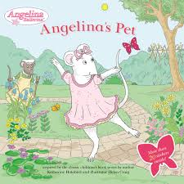
What’s the Lexile? Put these books in order from lowest to highest Lexile.

Slide 4
What’s the Lexile?
Angelina's Pet - 550
Night - 570
Adventures of Captain Underpants – 720
To Kill of Mockingbird - 790
Diary of a Wimpy Kid- 920

Slide 5
Goals for this hour:
Understand routines, mindsets, and classroom structures that grow readers as they progress through complex texts
Understand how read aloud, shared reading, small group, and independent reading ensure that students are engaged in texts
Understand structures that scaffold vocabulary to ensure students access grade level standards and texts
Understand the connection between the Virginia Standards of learning and the need for access to grade level texts to ensure equity for ALL students

Slide 6
Leveling & Labeling
Limitations, Equity, & Access

Slide 7
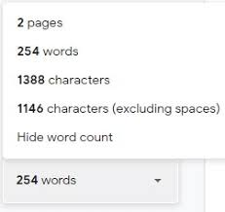
Quantitative Leveling has limitations!
Often computer generated and is based on word and syllable counts

Slide 8
Qualitative leveling…
Includes:
Levels of meaning or purpose
Structure
Language conventions and clarity
Background knowledge demands

Slide 9
Gradual Release
Who’s doing the work? Who’s accessing the text?

Slide 10
Gradual Release
I do it | We do it | Ya’ll do it | You do it
Read - aloud Think - aloud | Shared Reading | Small Group | Independent
- On and/or above level text - Teacher carries the weight of the reading and serves and the model for the thinking | - Grade level text - Teacher and students carry the weight of the reading - Students carry the weight of the thinking and responding - Teacher supports, as needed | - Text meets the reading needs of the students - Students carry the weight or the reading, thinking, and responding - Teacher supports, as needed, but this is the time for student problem-solving at the word and comprehension level | - Students read independently, often self-selected authentic text - Teacher support through conferring

Slide 11
Structures to Consider When Planning

Slide 12
Planning for Scaffolding
How do we utilize where our students are and scaffold to plan for all different structures for reading instruction?

Slide 13
A Hierarchy of Comprehension Goals: Fiction
A Hierarchy of Comprehension Goals | Fiction
Goal | Skills
Plot & Setting | Retell important events Synthesize cause and effect Identify problems Visualize setting
Character | Infer about, interpret, and analyze main character(s) Synthesize character change Infer about, interpret, and analyze secondary character(s)
Vocabulary and Figurative Language | Monitor for meaning and use context
Themes and Ideas | Interpret a story by naming life lesson(s) or theme(s) Identity and interpret social issues Identify and interpret symbols

Slide 14
A Hierarchy of Comprehension Goals: Nonfiction
A Hierarchy of Comprehension Goals | Nonfiction
Goal | Skills
Main Idea | Synthesize and infer to determine the main idea(s) of a page, section, or chapter Synthesize and infer to determine the main idea(s) of a whole book
Key Details | Determine importance to support a main idea with key details from the text Compare and contrast key details
Vocabulary | Monitor for meaning and use context
Text Features | Derive meaning from a text feature by synthesizing information from that feature, the text, and, if present, other text features

Slide 15
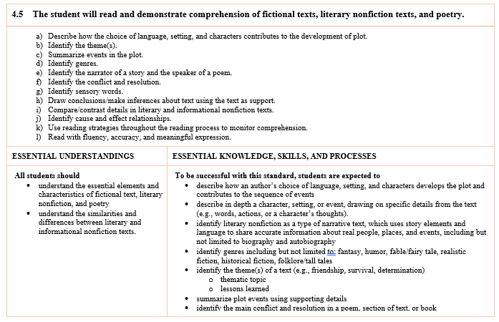
From the Curriculum Framework

Slide 16
Independent Reading
Reading Ladders

Slide 17
Playing the long game:
Access to books
Time to read
Building reading ladders
Responding to text (monitoring comprehension)
Readers are built, one book at a time

Slide 18
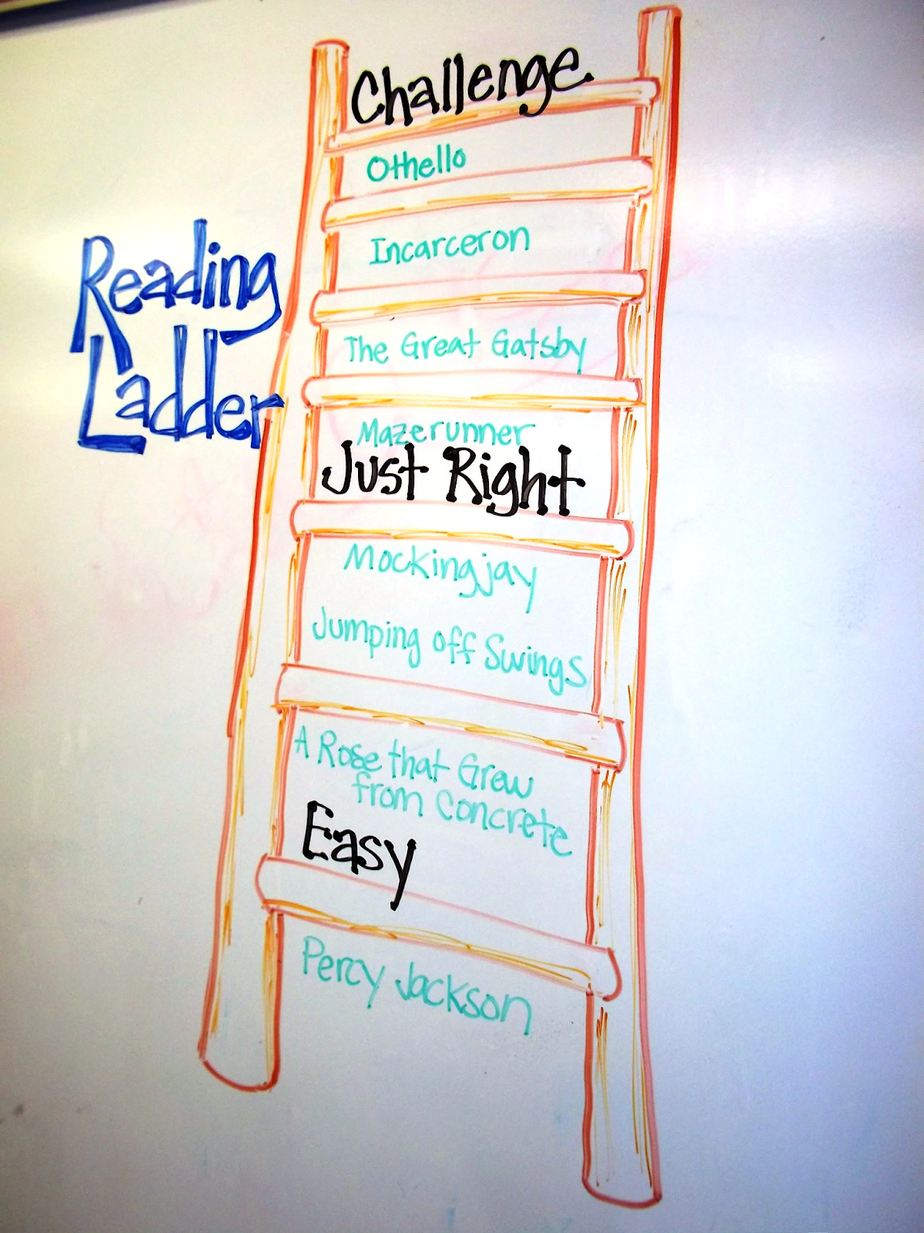
Let’s think two ways…
Planning intentionally for throughout the unit
Planning for the readers in your classroom throughout the year

Slide 19
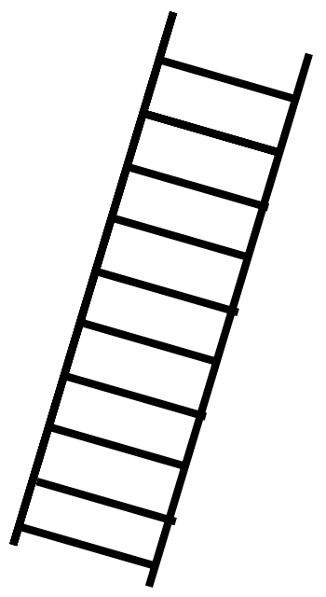
Figurative Language Reading Ladder
A Fire in My Hands (Gary Soto offers readers a collection of poems about a wide range of topics, including love and oranges.)
Hailstones and Halibut Bones (Similes, metaphors, and personification are all elements used to describe the sight, sound, smell, taste, and touch of various colors.)
There’s a Frog in My Throat! (Idiomatic expressions are the topic of this picture book.)
Crazy Like a Fox (An entire picture book is told through the use of similes.)
Quick as a Cricket (A child is compared to various animals using similes.)

Slide 20
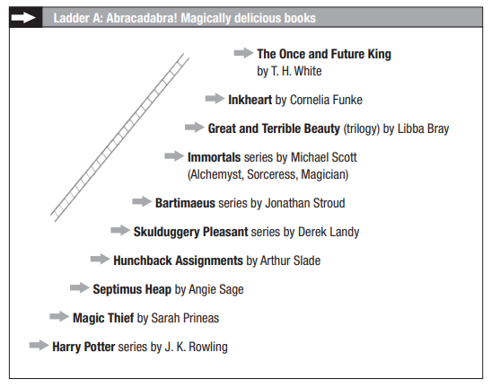
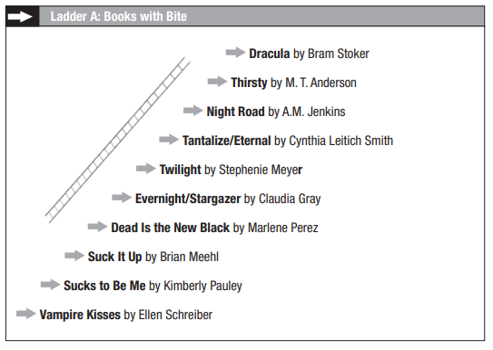
Sample Reading Ladders

Slide 21
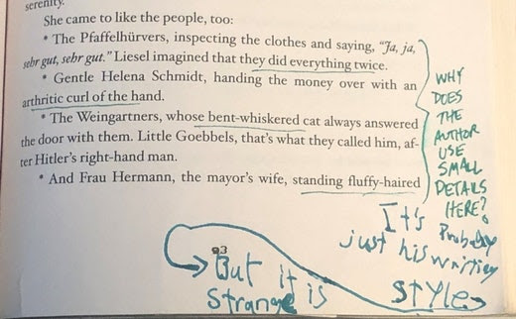
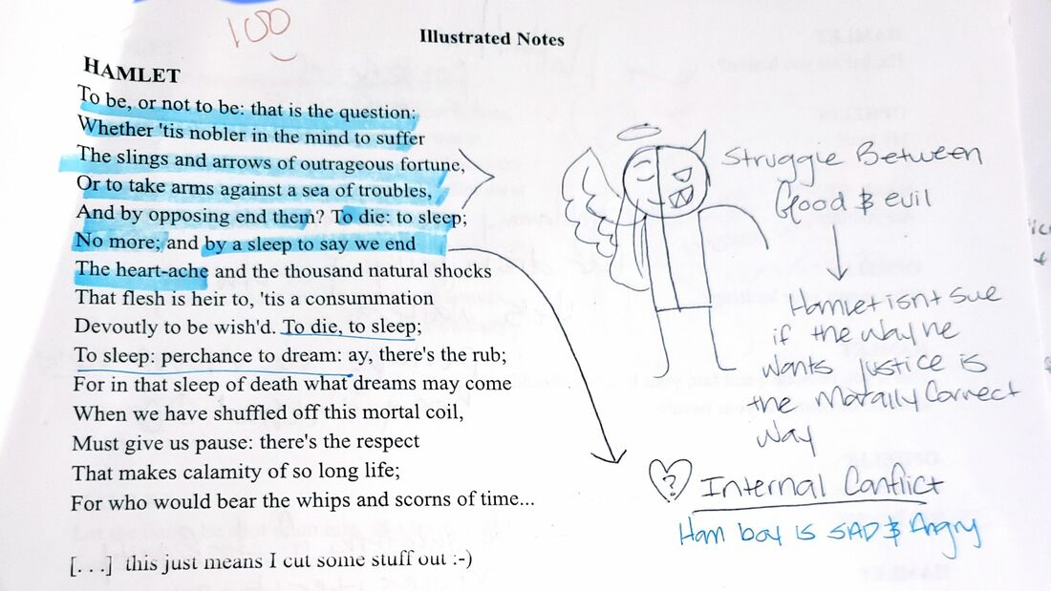
Responding to Text:
Students will tolerate assessments that they believe are worth the time and energy that they put into them

Slide 22
Vocabulary
Scaffolding & Planning for Vocabulary so ALL readers can access

Slide 23
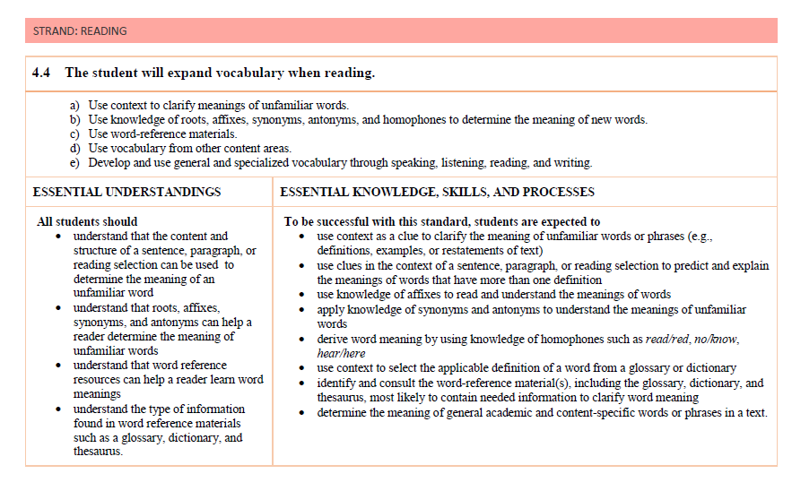
Back to the Standards:

Slide 24
Planning for whole group vocabulary instruction
Select grade to above grade level text that will interest YOUR students.
Read the text and select the words and/or phrases that may be challenging for YOUR students.
Determine which words may need to be tackled at the word level (decoding) first.
Determine which words have strong morphological support - previously taught roots and/or affixes.
Determine which words have strong context support. Which words have limited contextual support?
Find the phrases that may be troublesome for YOUR students.

Slide 25
Selected Vocabulary
Stray
https://www.commonlit.org/en/texts/stray
stray
snowdrifts swallowed up automobiles
wagging its tail timidly
trudged
grudgingly
The woman was sensitive about throwing out food.

Slide 26
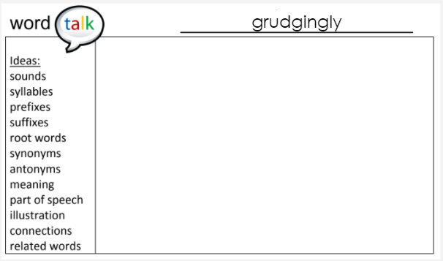
Word Talks

Slide 27
Skill Progression – 1st & 2nd Grade Vocabulary
Text Level | Characteristics
1st Grade | - Vocabulary and language is often familiar - Unfamiliar vocabulary tends to have strong picture support to help decipher meaning - Figurative language is rare
2nd Grade | - Most vocabulary is familiar - Unfamiliar vocabulary is supported by context and/or illustrations - Multiple meaning words and some figurative language used - need to be attentive to phrases, not just words - Metaphors & similes used more near the end of 2nd grade level text

Slide 28
Skill Progression – 3rd Grade Vocabulary
Text Level | Characteristics
3rd Grade | - New vocabulary is likely to be unexplained and the reader will need to rely on context - Figurative language more prevalent and must be interpreted, especially to understand character and plot - Connotative meanings in text that impact understanding - Dialogue used more often and may be untagged - Inference becomes important when reading and interpreting text

Slide 29
Skill Progression – 4th Grade Vocabulary
Text Level | Characteristics
4th Grade | - More challenging vocabulary in text and students need to own a strategy for determining meaning which often includes taking larger context into consideration (entire chapter) - Challenging vocabulary can make or break comprehension at this level - Inferring the meanings of words and phrases used figuratively is critical to comprehension - Narrators and characters may speak in unfamiliar ways or dialects

Slide 30
Skill Progression – 5th Grade Vocabulary
Text Level | Characteristics
5th Grade | - More use of figurative language and need to infer/interpret on the run - Cumulative knowledge of a story is often needed to explain the meaning of a word or phrase - Knowledge of more challenging words becomes critical to understanding the setting, characters, and theme - Poetic descriptions are more prevalent in books - Novels in verse require interpretation of figurative language and phrases

Slide 31
“A book about rain or the seashore may need a higher level [of scaffolding] for children living in a desert climate than for those residing in a coastal state.” -Gay Su Pinnell, Diane Deford, and Carol Lyons (1988)

Slide 32
Importance of Students Accessing Grade Level Text

Slide 33
Why?
Equity = access to complex, grade-level text
Access = appropriate scaffolding

Slide 34
Why – Explained:
A student is not solely their reading level. What a reading level is not:
Your initial data beginning of the year, may indicate the level at which a student is reading at that moment of time. BUT here’s what that data does not mean: “Daniel is reading at level 4, so I’ll send him to a group where all literacy instruction is in level 4 texts. He’s not ready for the level 7 books that most of his peers will be taught from.” Equity is not about lowering expectations.
Reading levels should not be about denying access; they should be understood mostly as indications of what it takes to grant access to complex, grade-level text.
Here’s what else that initial does not mean: “I’ll just report that reading level up the chain to the district, and then continue with my usual whole-class instruction in level 7 books, so it’s the same for everyone.” Equity is not about teaching the very same for everyone, regardless of needs.

Slide 35
Revisit our goals:
Understand routines, mindsets, and classroom structures that grow readers as they progress through complex texts
Understand how read aloud, shared reading, small group, and independent reading ensure that students are engaged in texts
Understand structures that scaffold vocabulary to ensure students access grade level standards and texts
Understand the connection between the Virginia Standards of learning and the need for access to grade level texts to ensure equity for ALL students

Slide 36
Disclaimer
Reference within this presentation to any specific commercial or non-commercial product, process, or service by trade name, trademark, manufacturer or otherwise does not constitute or imply an endorsement, recommendation, or favoring by the Virginia Department of Education.

Slide 37
Reach out & Follow Up! Lynn Smith brsmith@henrico.k12.va.us Emily McMillen emcmillen@henrico.k12.va.us

Slide 38
References
https://www.nwea.org/blog/2020/equity-in-reading-levels-scaffolds-and-grade-level-text/#:~:text=When%20students%20have%20a%20reading,making%20choices%20for %20independent%20reading
https://www.edutopia.org/blog/scaffolding-lessons-six-strategies-rebecca-alber
https://www.janaechevarria.com/?p=1484
https://www.readingrockets.org/blogs/shanahan-literacy/how-complex-text-can-i-scaffold
Who’s doing the Work? How to say less so readers can do more - Jan Burkins and Kim Yaris
Understanding Texts & Readers - Jennifer Serravallo
Reading Ladders: Leading students from Where they are to where we’d like them to be - Teri S. Lesesne
https://www.commonlit.org/en/texts/stray

