Slide 1
The Three /f/’s: Phonemic awareness, phonics, and facing facts about how we learn to read.
Savannah Campbell, Reading Specialist
Dr. Jennifer McSweeney, K-5 Instructional Literacy Specialist

Slide 2
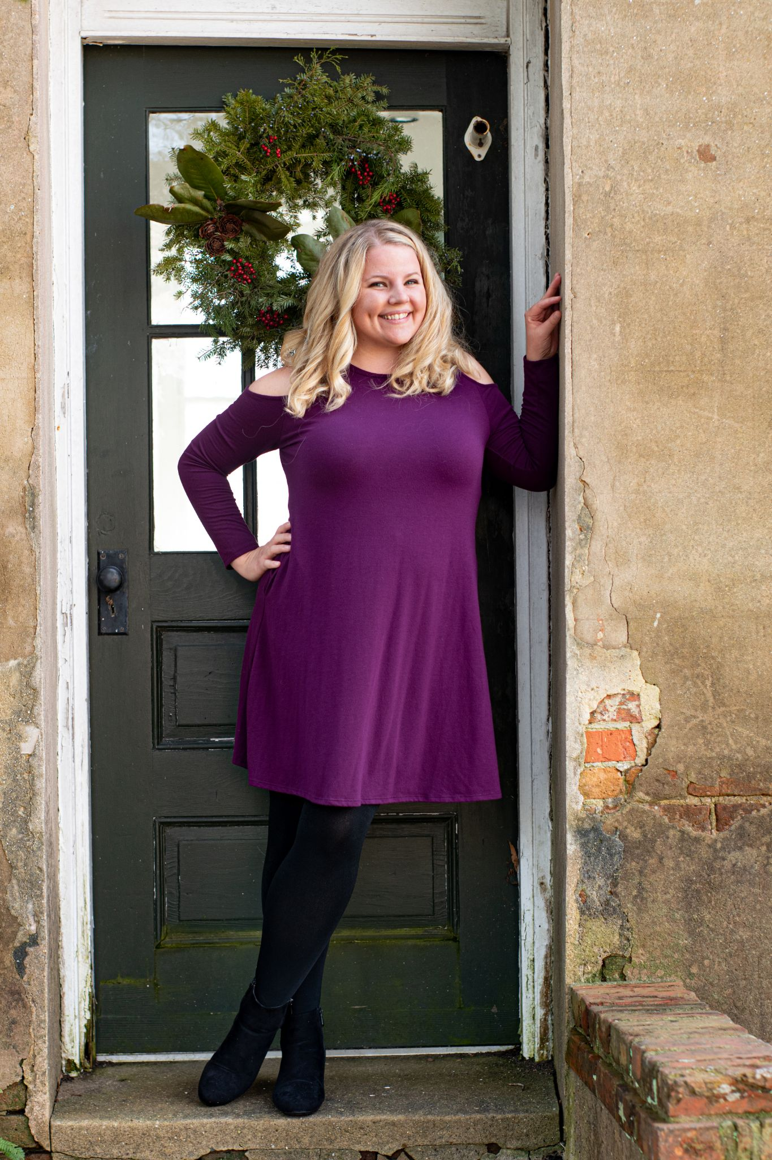
Who We Are
Dr. Jennifer McSweeney
Savannah Campbell

Slide 3
Introduction
Understanding the Reading Brain

Slide 4
Introduction: Anticipation Guide (True/False)
With best practices in place, research suggests 80% of our students can read on grade level.
According to research, we should tailor our instruction to meet the needs of auditory, visual, and kinesthetic learners.
Like language acquisition, our brains naturally develop the skills necessary to decode written symbols.
The two best indicators of how well a child will learn to read in the first two years of school are letter-sound knowledge and sight word vocabulary.
Only 40% English words can be decoded through sound-symbol correspondence alone.

Slide 5
Introduction: Scarborough’s Reading Rope
Understanding reading as it develops through time.
Reprinted with permission from Hollis Scarborough
Notes:
*The reading rope shows us development of readers over time. You can see, there are 2 main components--word recognition and language comprehension. They initially begin to develop outside of each other. later they become intertwined and develop into a skilled reader. The science of reading mainly focuses on word recognition, but meaning is always connected to words.

Slide 6
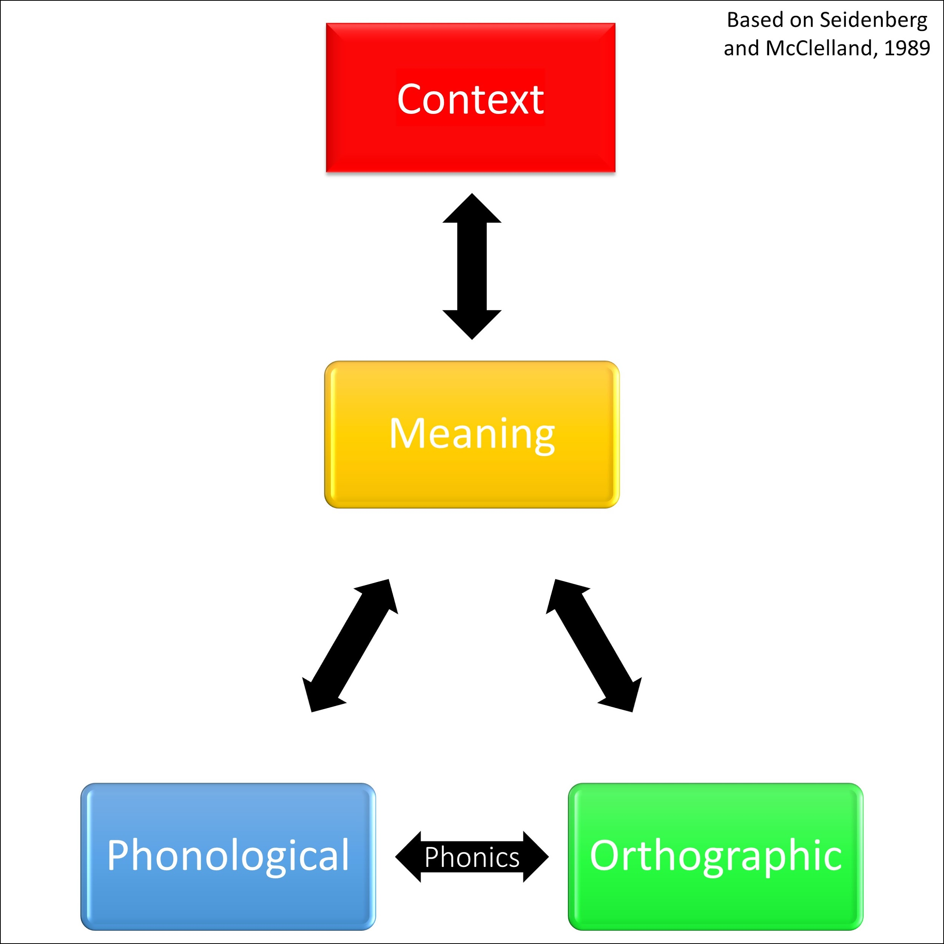
Introduction: 4 part processor (1 of 7)
4 part processor
Think about the word BAT.
-----------------------------------
Notes:
Phonological- enables us to perceive, remember, interpret, and produce sounds; helps us compare and distinguish words that sound familiar (fan/van); holds sounds in memory, includes manipulation of sounds
Orthographic- recognition and recall of written language symbols; formation of letters- squiggles, lines, curves; recognizes correct spellings of words
Meaning- interprets meanings of words in and out of context; includes vocabulary, roots, prefixes and suffixes, multiple meanings, spelling patterns
Context- interacts with and supports the meaning; refers to the use of a word in a sentence; provides meaning when words have multiple meanings

Slide 7
Introduction: 4 part processor (2 of 7)
4 part processor
Let’s try some examples:
1. Can you tell me 3 meanings of the words pitch?
Notes:
Phonological- enables us to perceive, remember, interpret, and produce sounds; helps us compare and distinguish words that sound familiar (fan/van); holds sounds in memory, includes manipulation of sounds
Orthographic- recognition and recall of written language symbols; formation of letters- squiggles, lines, curves; recognizes correct spellings of words
Meaning- interprets meanings of words in and out of context; includes vocabulary, roots, prefixes and suffixes, multiple meanings, spelling patterns
Context- interacts with and supports the meaning; refers to the use of a word in a sentence; provides meaning when words have multiple meanings

Slide 8
Introduction: 4 part processor (3 of 7)
4 part processor
Let’s try some examples:
1. Can you tell me 3 meanings of the words pitch?
2. In the sentence, “Medusa had locks made of snakes”, what does the word locks mean?
Notes:
Phonological- enables us to perceive, remember, interpret, and produce sounds; helps us compare and distinguish words that sound familiar (fan/van); holds sounds in memory, includes manipulation of sounds
Orthographic- recognition and recall of written language symbols; formation of letters- squiggles, lines, curves; recognizes correct spellings of words
Meaning- interprets meanings of words in and out of context; includes vocabulary, roots, prefixes and suffixes, multiple meanings, spelling patterns
Context- interacts with and supports the meaning; refers to the use of a word in a sentence; provides meaning when words have multiple meanings

Slide 9
Introduction: 4 part processor (4 of 7)
4 part processor
Let’s try some examples:
1. Can you tell me 3 meanings of the words pitch?
2. In the sentence, “Medusa had locks made of snakes”, what does the word locks mean?
3. Say pale. Say it again but don’t say /l/.
Notes:
Phonological- enables us to perceive, remember, interpret, and produce sounds; helps us compare and distinguish words that sound familiar (fan/van); holds sounds in memory, includes manipulation of sounds
Orthographic- recognition and recall of written language symbols; formation of letters- squiggles, lines, curves; recognizes correct spellings of words
Meaning- interprets meanings of words in and out of context; includes vocabulary, roots, prefixes and suffixes, multiple meanings, spelling patterns
Context- interacts with and supports the meaning; refers to the use of a word in a sentence; provides meaning when words have multiple meanings

Slide 10
Introduction: 4 part processor (5 of 7)
4 part processor
Let’s try some examples:
1. Can you tell me 3 meanings of the words pitch?
2. In the sentence, “Medusa had locks made of snakes”, what does the word locks mean?
3. Say pale. Say it again but don’t say /l/.
4. Match uppercase with corresponding lowercase letters.
Notes:
Phonological- enables us to perceive, remember, interpret, and produce sounds; helps us compare and distinguish words that sound familiar (fan/van); holds sounds in memory, includes manipulation of sounds
Orthographic- recognition and recall of written language symbols; formation of letters- squiggles, lines, curves; recognizes correct spellings of words
Meaning- interprets meanings of words in and out of context; includes vocabulary, roots, prefixes and suffixes, multiple meanings, spelling patterns
Context- interacts with and supports the meaning; refers to the use of a word in a sentence; provides meaning when words have multiple meanings

Slide 11
Introduction: 4 part processor (6 of 7)
4 part processor
Let’s try some examples:
1. Can you tell me 3 meanings of the words pitch?
2. In the sentence, “Medusa had locks made of snakes”, what does the word locks mean?
3. Say pale. Say it again but don’t say /l/.
4. Match uppercase with corresponding lowercase letters.
5. Tell me a word that is the opposite of proud.
Notes:
Phonological- enables us to perceive, remember, interpret, and produce sounds; helps us compare and distinguish words that sound familiar (fan/van); holds sounds in memory, includes manipulation of sounds
Orthographic- recognition and recall of written language symbols; formation of letters- squiggles, lines, curves; recognizes correct spellings of words
Meaning- interprets meanings of words in and out of context; includes vocabulary, roots, prefixes and suffixes, multiple meanings, spelling patterns
Context- interacts with and supports the meaning; refers to the use of a word in a sentence; provides meaning when words have multiple meanings

Slide 12
Introduction: 4 part processor (7 of 7)
4 part processor
Let’s try some examples:
1. Can you tell me 3 meanings of the words pitch?
2. In the sentence, “Medusa had locks made of snakes”, what does the word locks mean?
3. Say pale. Say it again but don’t say /l/.
4. Match uppercase with corresponding lowercase letters.
5. Tell me a word that is the opposite of proud.
6. What is the second sound in the word clean?
Notes:
Phonological- enables us to perceive, remember, interpret, and produce sounds; helps us compare and distinguish words that sound familiar (fan/van); holds sounds in memory, includes manipulation of sounds
Orthographic- recognition and recall of written language symbols; formation of letters- squiggles, lines, curves; recognizes correct spellings of words
Meaning- interprets meanings of words in and out of context; includes vocabulary, roots, prefixes and suffixes, multiple meanings, spelling patterns
Context- interacts with and supports the meaning; refers to the use of a word in a sentence; provides meaning when words have multiple meanings

Slide 13
Introduction: Connecting Science Of Reading to
Standards of Learning
4-part processor | Kindergarten | 1st Grade | 2nd Grade
Phonological | K.1, K.2 Communication K.3 Phonological & phonemic awareness | 1.1, 1.2 Communication 1.3 Phonological & phonemic awareness | 2.1, 2.2 Communication 2.3 Phonemic awareness
Orthographic | K.4 Understand print K.5 Print conveys meaning K.6 Understand phonetic principles K.10 Print letters K.11 Write and compose | 1.4 Understand print 1.5 Apply phonetic principles 1.11 Print letters 1.12 Write and compose | 2.4 Use phonetic strategies 2.9 Print letters 2.10 Write and compose
Meaning | K.7 Vocabulary | 1.6 Use semantic clues 1.7 Vocabulary | 2.5 Use semantic clues 2.6 Vocabulary
Context | K.8 Comprehend Fiction K.9 Comprehend Nonfiction | 1.9 Comprehend fiction 1.10 Comprehend nonfiction | 2.7 Comprehend fiction 2.8 Comprehend nonfiction
Notes:
Jennifer
K- Communication strand
1st- writing strand
2nd- reading strand
across grades- understand, apply to read and spell, use knowledge to read and spell

Slide 14
Phonemic Awareness
The ability to identify and manipulate individuals sounds in spoken language.

Slide 15
Phonemic Awareness: Quote
“If you provide kindergarteners with (a) direct and explicit phonological awareness training, (b) ample letter-sound instruction, and (c) if you teach the connections between those two, you will substantially reduce the number of students struggling in reading at the end of first, second, and even later grades”(Kilpatrick, 2015, 12).

Slide 16
Phonemic Awareness: Kindergarten SOLS
K.3 The student will orally identify, segment, and blend various phonemes to develop phonological and phonemic awareness.
a) Begin to discriminate between spoken sentences, words, and syllables.
b) Identify and produce words that rhyme.
c) Blend and segment multisyllabic words at the syllable level.
d) Blend and segment one-syllable words into phonemes including onset and rime.
e) Identify words according to shared beginning and/or ending sounds.
f) Blend sounds to make one-syllable words.
g) Segment one-syllable words into individual phonemes.

Slide 17
Phonemic Awareness: First and Second Grade SOLS
1.3 The student will orally identify, produce, and manipulate various phonemes within words to develop phonological and phonemic awareness.
a) Create rhyming words.
b) Count phonemes (sounds) in one-syllable words.
c) Blend sounds to make one-syllable words.
d) Segment one-syllable words into individual phonemes.
e) Add or delete phonemes to make new words.
f) Blend and segment multisyllabic words at the syllable level.
2.3 The student will orally identify, produce, and manipulate various phonemes within words to develop phonemic awareness.
a) Count phonemes within one-syllable words.
b) Blend sounds to make one-syllable words.
c) Segment one-syllable words into phonemes.
d) Add or delete phonemes to make words.
e) Blend and segment multisyllabic words at the syllable level.

Slide 18
Phonemic Awareness: Daily Practice
Segmenting: taking apart individual sounds
Blending: putting individual sounds together
Adding: inserting individual sounds
Deleting: removing individual sounds
Substituting: replace an individual sound for another one
Notes:
Can be done with the words you have for spelling. Pick 1-2 skills to focus on. Remember, manipulatives are not the end goal. The end goal is automaticity without any kind of manipulative. Just like in math, these are scaffolds.

Slide 19
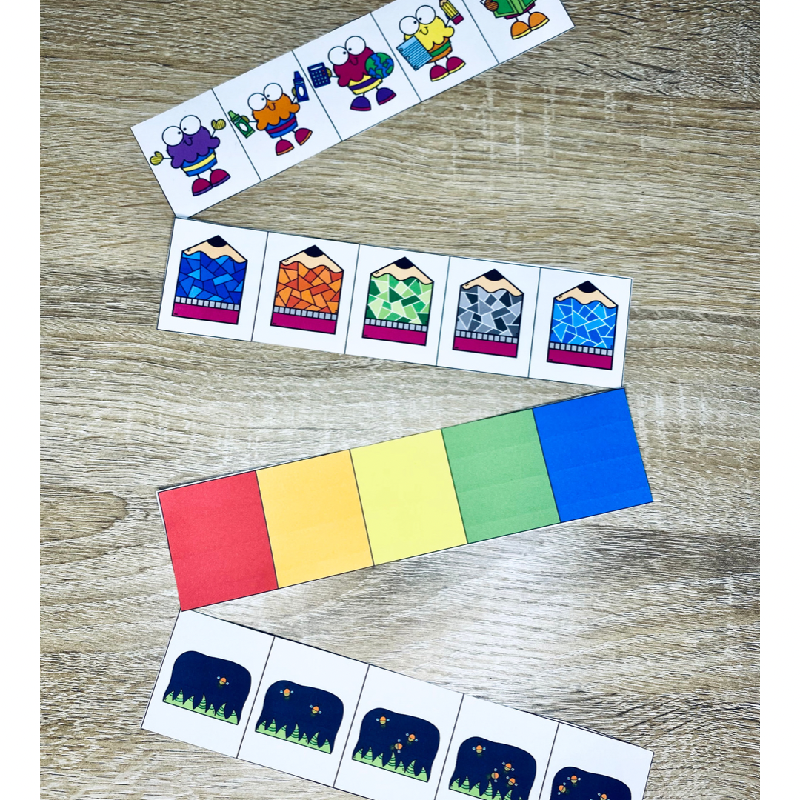
Phonemic Awareness: Additional Ideas

Slide 20
Phonics
The method by which we teach children to translate speech sounds into written symbols.

Slide 21
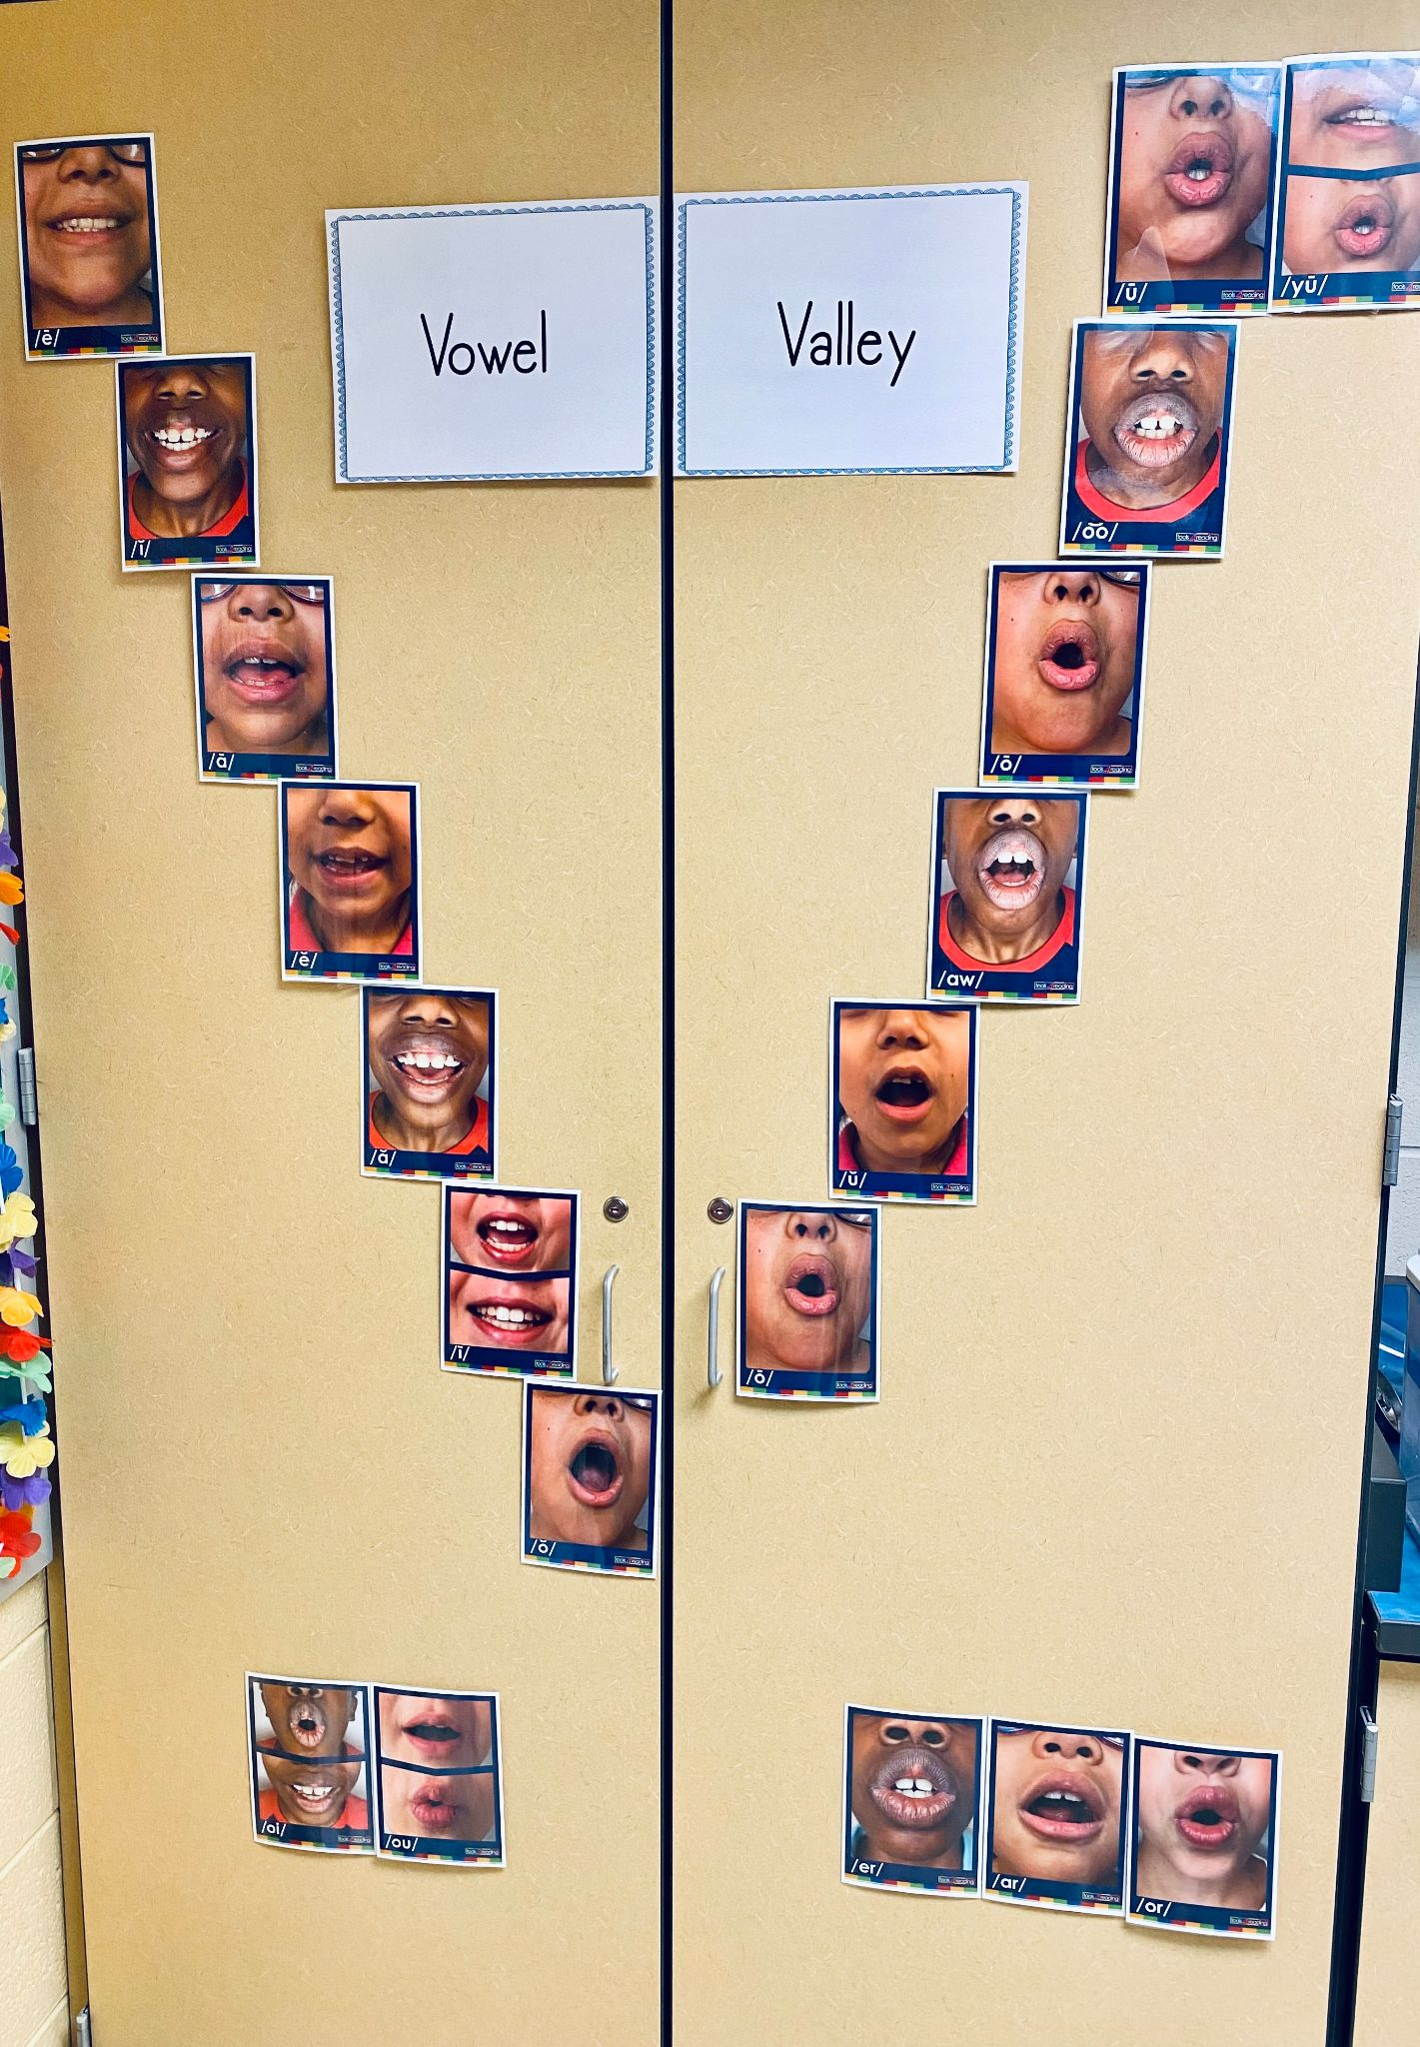
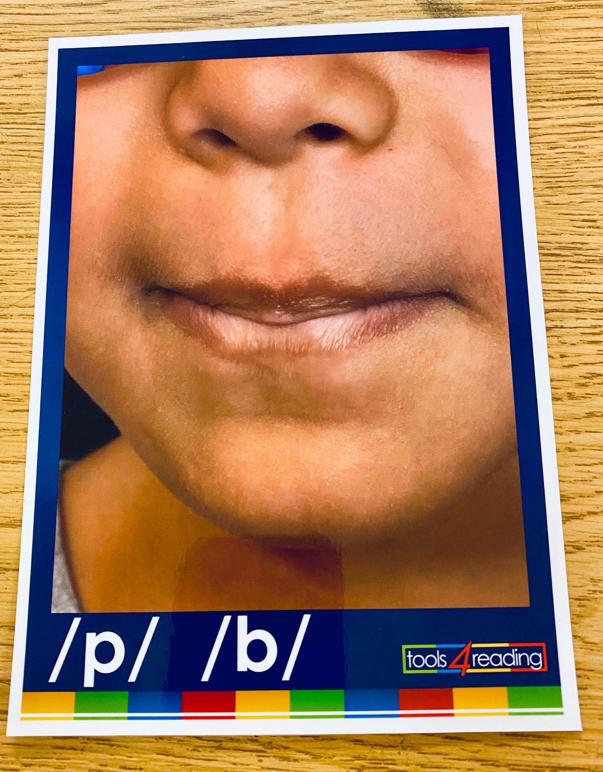
Phonics: Sound Walls vs. Word Walls
Notes:
*talk about how word walls are not effective for retrieval of words. Where would I go if I wanted to find about, of, this?
*sound walls are organized by sounds. More specifically, they are organized by where the sound is made in your mouth. Talk about front

Slide 22
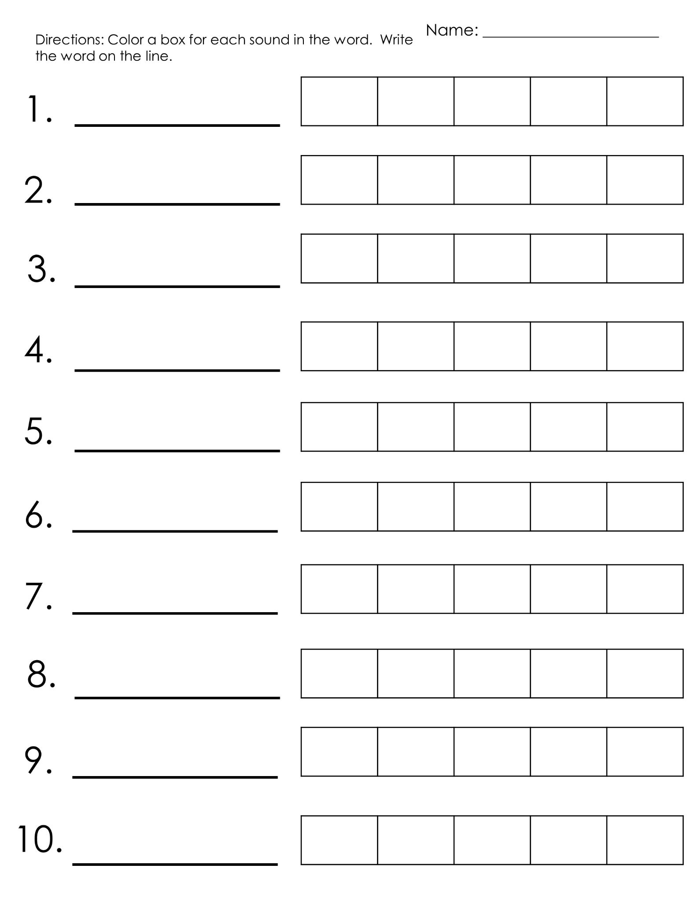
Phonics: Sound-symbol correspondence
Think about the 4-part processor:
How many sounds?
How will we write this?
What does it mean?
Use it in a sentence.
Examples: stick, jeep, wedge
Tap it, Map it, Graph it, Zap it
Notes:
As students are learning sounds, they will begin to move from sounds to print. There is a process for this movement to phonics.
(read these directions and then demonstrate)
Say the word and have students repeat the word. Tap it out.
How many sounds are in the word?
How do we write this? (Some phomenes have more than one grapheme, or letter, to represent the sound.)
What does the word mean?
Use it in a sentence.

Slide 23
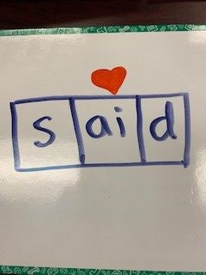
Phonics: Heart Words
What is a sight word?
Why should we teach heart words?
Let’s try:
said- 1st
below- 2nd
people- 3rd

Slide 24
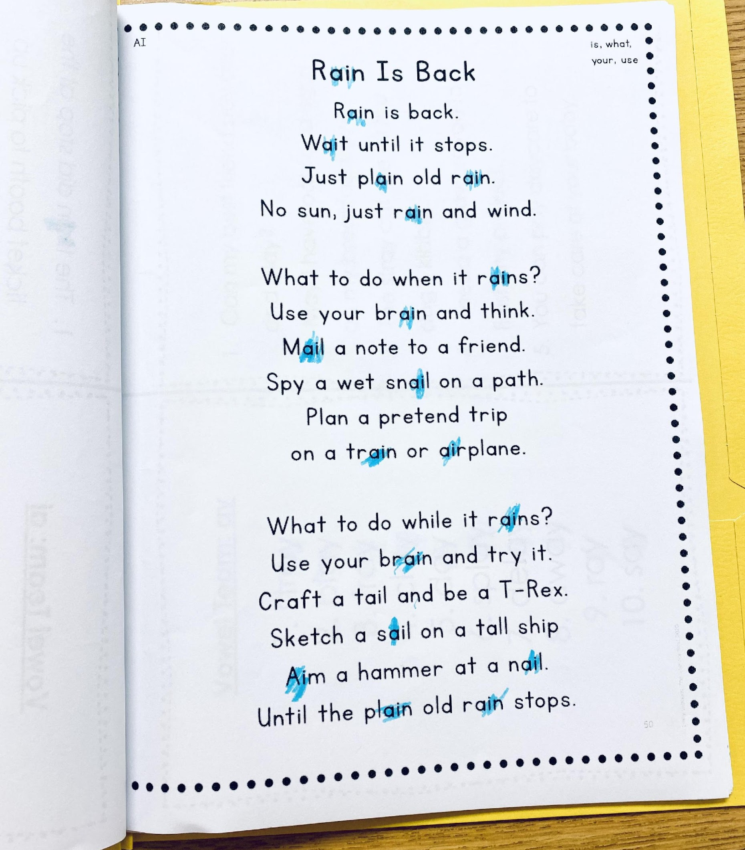
Phonics: Decodables
Why?
Students need to practice what they learn. If they learn to read words, they will learn to love reading.
How?
Read the passage, highlight words, choral read, reread
What do they look like?
You will see many of the words and features students have learned or are learning.

Slide 25
Conclusion/Final Thoughts
“There is no comprehension strategy powerful enough to compensate for the fact that you can’t read the words”(Archer & Hughes, 2010, Guilford Press.)
Notes:
“If broadly applied, our best interventions could take the number of struggling readers from about 30%-34% of the population down to about 5%, and the percentage of students with the more significant reading difficulties and disabilities could be closer to 1%-2%(Kilpatrick, 2015, 288).

Slide 26
Conclusion: Anticipation Guide
With best practices in place, research suggests 80% of our students can read on grade level. (False)
According to research, we should tailor our instruction to meet the needs of auditory, visual, and kinesthetic learners. (False)
Like language acquisition, our brains naturally develop the skills necessary to decode written symbols. (False)
The two best indicators of how well a child will learn to read in the first two years of school are letter-sound knowledge and sight word vocabulary. (False)
Only 40% English words can be decoded through sound-symbol correspondence alone.(False)

Slide 27
Contact Information
Savannah Campbell : savannah.campbell@gc.k12.va.us
Savannah is a Reading Specialist for Gloucester County Public Schools. She has been teaching for 10 years and has experience as a 4th grade teacher, 3rd grade teacher, 1st grade teacher, and as a Reading Specialist. She holds two masters degrees from William and Mary--one in elementary education and one in Literacy Leadership. Savannah is Orton-Gillingham and LETRS trained. Her greatest hope in life is to help all children access the written code of English, so that they can become successful with whatever path they choose.
Dr. Jennifer McSweeney: jmcsweeney@gc.k12.va.us
Jennifer is the K-5 Instructional Literacy Specialist for Gloucester County Public Schools. She was a teacher for 20 years and has experience as a special education teacher, a 2nd grade teacher, 3rd grade teacher, 6th-8th teacher, and a reading specialist. She holds a master’s degree in reading and an Ed. D in Educational Policy, Planning, and Leadership. Jennifer is a Local LETRS Facilitator for her county. Her mission is to make a difference in the reading lives of children, families, and all teachers within their school buildings.

Slide 28
References
Adams, Marilyn Jager (1990). Beginning to read: Thinking and learning about print. Cambridge, MA: Bolt, Beranek, and Newman, Inc.
Archer, A.; Hughes, C.A. (2010). Explicit instruction: Effective and efficient teaching. New York: Guilford Press.
Kilpatrick, D. (2015). Essentials of assessing, preventing, and overcoming reading difficulties. John Wiley & Sons.
Scarborough, H. S. (2001). Connecting early language and literacy to later reading (dis)abilities: Evidence, theory, and practice. In S. Neuman & D. Dickinson (Eds.), Handbook for research in early literacy (pp. 97-110). New York: Guilford Press.
Seidenberg, M. S., & McClelland, J. L. (1989). A distributed, developmental model of word recognition and naming. Psychological Review, 96(4), 523-568.
Word wall images from Tools4Reading and Meredith Nardone at Creativity to the Core.
Decodable text courtesy of Emily Gibbons at The Literacy Nest.

Slide 29
Disclaimer
Reference within this presentation to any specific commercial or non-commercial product, process, or service by trade name, trademark, manufacturer or otherwise does not constitute or imply an endorsement, recommendation, or favoring by the Virginia Department of Education.

