Slide 1
It’s All Fun and Games-Phonemic Awareness
Nicole Ball and Carrie Leestma

Slide 2
Welcome and Introductions
Nicole Ball-Educational Specialist, Early Childhood and Language Arts, Fairfax County Public Schools
nmball@fcps.edu
Carrie Leestma-Educational Specialist, Dyslexia and Language Arts, Fairfax County Public Schools
csleestma@fcps.edu

Slide 3
Outcomes
Understand phonological awareness and phonemic awareness and why it is important
Learn how students typically progress in phonological awareness
Explore games that develop PA in fun and developmentally appropriate ways and learn places to embed these games

Slide 4
Let’s Play a Game-Nutty Names
This game works on phoneme substitution
Pull a picture card
The beginning sound of the picture chosen will replace the beginning sound in your first name
Model this step with your own name and one or two other names
Have students try with another name
Then play the game using a different picture
Notes:
**Share a game card**
Let’s play a game before we get started. Explain the game first and the have the participants use their mic or the chat box to share their new name. Play a manipulation game with our names (sub with the /v/ sound). I am Vicole Vall and this is Varrie Veestma, use the chat box and type your new name.

Slide 5
From Early Childhood Literacy Development Brief
“The International Literacy Association maintains that phonological awareness has a critical role in early literacy and language development. Purposeful, efficient, and developmentally appropriate instruction in phonological awareness can support young children’s literacy and language development and help them understand how to decode and spell words, particularly when combined with instruction in both alphabet and vocabulary knowledge.”
Phonological Awareness in Early Childhood Literacy Development Brief, 2019

Slide 6
Fast Facts
Without direct instruction, at least 25% students will struggle with phonemic awareness.
-Adams, 1990
Phonemic awareness is the strongest predictor of reading success or failure. Even higher than IQ.
-Adams, 1990; Stanovich, 1986
Instruction in phonemic awareness can accelerate reading and writing progress.
-Ball & Blachman, 1991
Notes:
Ball & Blachman, 1991; Blachman, Ball, Black, & Tangel, 1994; Bradley & Bryant, 1983; Byrne & Fielding-Barnsley, 1991, 1993, 1995; Caslte, Riach, & Nicholson, 1994; Cunninghman, 1990; Lundberg et al., 1988; Wallahc & Wallach, 1979; Williams, 1980

Slide 7
Phonological and Phonemic Awareness
Phonological Awareness
The ability to listen to, recognize, and manipulate the sounds of language.
Phonemic Awareness
The ability to listen to, recognize and manipulate the individual sounds in spoken words.
Notes:
Talk about the differences and how this is not phonics. Give a few examples of what makes each portion.

Slide 8
Phonological awareness is not phonics

Slide 9
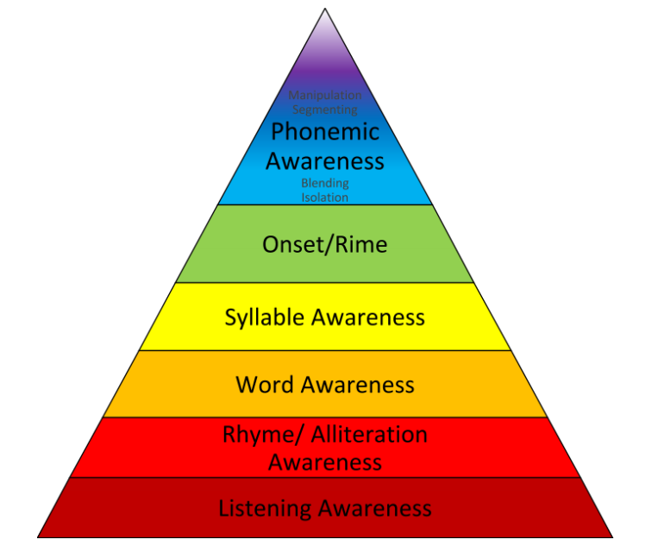
How Phonological Awareness Typically Develops
Power Skills: Blending and Segmenting
Notes:
We start with the largest pieces of language and move to smaller pieces, just as we did in our Nutty Names game. We were manipulating a small portion of a word. We are working first on large pieces of language such as sentences, then we move to words and then to parts of words such as syllables. Even within syllables, there are larger more meaningful pieces that you may want to work with first, such as compound words.
Adapted from: https://faculty.virginia.edu/ReadingFirst/prof_dev/phonemic_awareness/rhy_alliter.html

Slide 10
Large Pieces to Small Pieces
Large to small pieces of language and words
Initial, Final, Medial
Notes:
It is much easier to work with the bigger pieces of language and words before moving to the smaller pieces. For example, it is much easier to work with a word like rainbow then it is to work with onset and rime such as /r/ ain
Children also are more likely to hear beginning sounds before ending sounds and these before medial. Keep these progressions in mind as you teach.

Slide 11
Parts of Words
Compound Words
cupcake
Syllables
but-ter-fly
Onset-Rime
st-ar
Phonemes
/b/ /ǔ/ /g/

Slide 12
Let’s Play a Game-Noisemakers
This game works on listening attentively
Pull a picture card that includes an action such as clapping, or patting knees
Tell students that you will show an action the students can perform when you say, “Noisemakers on.”
Tell students that when you say, “Noisemakers off” they must stop the action.
Model this one or two times

Slide 13
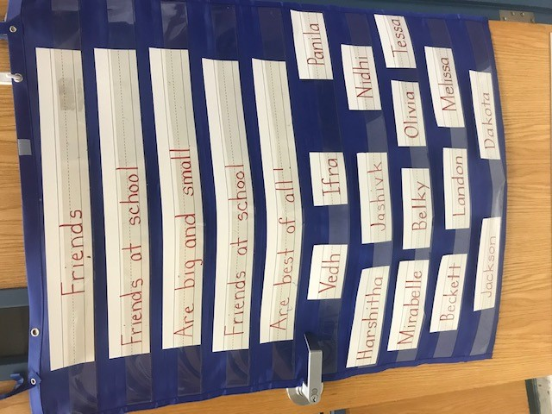
It All begins with Exposure

Slide 14
Progression
Exposure
Recognition
Production

Slide 15
Explicit Language and a Gradual Release

Slide 16
What is Explicit Instruction?
1- State the learning objective
2- Break the learning into chunks
3- Model the concept
4- Think aloud your process
5- Provide opportunities for practice
6- Feedback
Notes:
From Explicit Instruction: What you need to know by Kim Green from the website www.Understood.org

Slide 17
Explicit Language Sounds Like...
“Rhyming words sound the same in the middle and at the end of a word, listen to these two words: cat and rat. Can you hear how they sound the same in the middle and at the end?”
“We can listen carefully to the beginning of a word to hear the first sound, listen carefully to the words mouse and map. Can you hear how they sound the same at the beginning?”
“Words have parts called syllables, and we can put our hand under our chin to feel the parts of a word, watch and listen as I show you.”

Slide 18
Let’s Play a Game-Let’s Go Shopping...
This game works on building production of rhyme
Have students sit in a circle. Begin with a sentence starter such as, “I am going shopping for cheese”.
Toss a ball to a student and they must repeat the sentence starter and produce a word that rhymes with the last word you gave (ex: Let’s go shopping for peas).
The student will then toss the ball back to the teacher and then the teacher will repeat the original rhyme and toss the ball to another student.
Continue until students run out of rhymes and then create a new item to shop for (ex: Let’s go shopping for hats).
**You may also accept nonsense words from students or use picture cards to support students who need a scaffold**

Slide 19
Assessment Leads to Instruction
PALS
Informal assessment during games

Slide 20
Games
Used to reinforce explicitly taught skills
Can be done whole class or in small groups

Slide 21
Game-Put the Syllable in the Corner
This game works on strengthening students segmentation of syllables
Begin by labeling corners or places in your room with a number.
Pass out picture cards to students (individually or in pairs).
Student segments the picture by placing their hand under their chin and then goes to the corner with the number that matches and hold sup theri picture(ex: butterfly-3).
Students then trade pictures with a friend and begin again.
**Be sure to use pictures that are familiar to students**

Slide 22
Quote
“The entire activity should be playful and enjoyable. Too much specific attention to sounds-as if it is a task to be done correctly-not only confuses children but also shuts them down to the delight and enjoyment of learning about language. It is natural for children to play with the sounds of words. Weir’s study of children in their cribs revealed that children practiced new words and sounds as they lulled themselves to sleep. You want to build on this natural curiosity and help children play with sounds in words in your classroom with that same spirit of delight in discovery.”
Fountas and Pinnell

Slide 23
Throughout the Day
Morning activities (Memory Games, matching games)
Morning Meeting Activity
Transitions
Brain Breaks
Literacy Stations
Notes:
Add in our rhyming throughout the day card

Slide 24
Tips for English Language Learners
Draw upon words that are familiar to the children.
Value children’s language responses.
Learn about the child’s native language.
Pronounce sounds clearly.
Provide visuals (picture cards, real objects).
Be thoughtful about how much you are teaching at one time.

Slide 25
Game-Guess My Word
This game works on strengthening students listening and blending skills
Explain to students that they will be playing a game where they must listen carefully and then blend the sounds to make a new word.
Model saying a word slowly, phoneme by phoneme (ex: /s//u//n/). Then say all the sounds quickly together (ex: sun)
Choose another word that is familiar to students and say it slowly, students then put them together quickly to “Guess the word”.
Begin again with a new word
**Be sure to use words that are familiar to students**

Slide 26
Questions ??

Slide 27
References
https://www.literacyworldwide.org/docs/default-source/where-we-stand/9457_Phonological_Awareness_1-2020_Final.pdf
Phonemic Awareness in Young Children-Marilyn J. Adams
A Fresh Look at Phonics-Wiley Blevins
https://www.readingrockets.org/article/development-phonological-skills
https://faculty.virginia.edu/ReadingFirst/prof_dev/phonemic_awareness/rhy_alliter.html
https://www.google.com/url?q=https://www.understood.org/en/school-learning/for-educators/universal-design-for-learning/what-is-explicit-instruction&sa=D&source=editors&ust=1622073826324000&usg=AOvVaw27CCPTWi23C5jBZ4VFBGu4&safe=active&surl=1
Words Their Way for PreK-K-Johnston, Invernizzi
Phonemic Awareness- Creative Teaching Press

Slide 28
VDOE Disclaimer
Reference within this presentation to any specific commercial or non-commercial product, process, or service by trade name, trademark, manufacturer or otherwise does not constitute or imply an endorsement, recommendation, or favoring by the Virginia Department of Education.

