Slide 1
A Blank Sheet of Paper
Reflecting on Reading
Grades K-2
Elizabeth Ross and Maureen Houser
Hampton City Schools Educators

Slide 2
Standards of Learning
Kindergarten: K.1 c,e,f K.8 c,d,e K.9 a-c
First Grade: 1.1 e,k 1.9 a-i 1.10 a-h
Second Grade 2.1 g,h,l 2.7 a-i 2.8 a-h

Slide 3
During your reading block: How do your students reflect on their independent or whole group reading?

Slide 4
Scarborough’s Reading Rope
LANGUAGE COMPREHENSION
Background Knowledge
Vocabulary Knowledge
Verbal Reasoning
Literacy Knowledge
Increasingly strategic
SKILLED READING: FLUENT EXECUTION AND COORDINATION OF WORD RECOGNITION AND TEXT COMPREHENSION
WORD RECOGNITION
Phonological Awareness
Decoding (and Spelling)
Sight Recognition
Increasingly automatic
arr
Notes:
Maureen

Slide 5
Text + Thinking = Real Reading

Slide 6
“Reading without reflecting is like eating without digesting”
-Edmund Burke
Notes:
Ross

Slide 7
Checking in
In each reflection, students are able to summarize the important concepts of reading and describe what was interesting, surprising, or confusing to them. For an instructor, reading reflection facilitate “just-in-time” teaching and provides invaluable insights into students’ thinking and learning.-unknown
Notes:
Ross

Slide 8
Reflecting on a text students might ...
make a connection between their own life and the text
make a connection between other readings and the text
create a visual image
make an inference about the meaning
generate questions about the text
summarize and determine the most important message in the text
give them a voice
Notes:
Ross

Slide 9
How do you engage your students?
“WITHOUT ENGAGEMENT WE GOT NOTHING”
-JENNIFER SERRAVALLO
Notes:
Ross

Slide 10
REFLECTING
PREDICTING INFERRING QUESTIONING SYNTHESIZING
Notes:
Maureen

Slide 11
Look For -
FICTION
characters
setting
conflict
resolution
ASK YOURSELF
IS THIS A STORY?
NONFICTION
main idea
facts
table of contents
text features
ASK YOURSELF
IS THIS TEACHING ME ABOUT FACTS?
Notes:
Ross

Slide 12
Materials needed-
a blank sheet of paper
text
grade level, instructional level or independent level
writing utensil
Notes:
Maureen

Slide 13
The Art of the Fold
fold in 3 columns
fold with 4 boxes

Slide 14
FICTION
“STORY talk”
Notes:
Fiction is a story fiction story it has 4 parts –

Slide 15
STRATEGY #1
STORY MAP

Slide 16
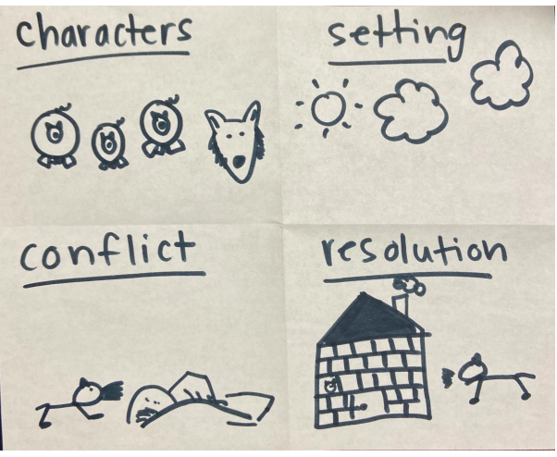
suitcase fold – story elements

Slide 17
STRATEGY #2
BEGINNING-MIDDLE-END
Notes:
Beginning-middle-end sign language

Slide 18
Burrito fold B-M-E
B
M
E
The first little pig built his house of straw and the wolf blew it down.
The second little pig built his house of sticks and the wolf blew it down.
The third little pig built his house of bricks and was safe from the wolf.

Slide 19
STRATEGY #3
MULTIPLE RESPONSES

Slide 20
Examples of Multiple Response
A
B
Opinion
Fact
C
D
Write or draw your prediction
*there are various ways you can use this strategy. Can be adapted to the standard of learning you are teaching*

Slide 21
NONFICTION
“FACT talk”
Notes:
Maureen

Slide 22
STRATEGY #1
MAIN IDEA AND DETAILS

Slide 23
Topic-Main Idea-Details

Slide 24
STRATEGY #2
SUMMARIZE

Slide 25
Using Verbs
Cheetahs
can
have
are
*claws
* cubs
*fur
*mammals
*carnivores
* fast
*found in Africa
*Climb trees
* run fast
*hunt

Slide 26
STRATEGY #3
ASK AND ANSWER QUESTIONS

Slide 27
Spin a question
When?
When do cheetahs hunt?
Why do cheetahs have a long tail?
How do cheetah cubs play with each other?
Where do cheetahs live?
How?
Where?
Why?

Slide 28
WAYS TO ADAPT THE STRATEGIES
model for students
instead of having students write/draw point to each section and talk it out
instead of pictures have students write sentences
instead of writing sentences have students draw pictures

Slide 29
Resources:
McGregor, T. (2007). Comprehension connections: bridges to strategic reading. Heinemann.
Serravallo, J. (2020). Connecting with Students Online: Strategies for Remote Teaching & Learning. Heinemann.

Slide 30
Still have questions or a creative way to use a blank sheet of paper?
We would love to hear from you!!
Elizabeth Ross eross1@hampton.k12.va.us
Maureen Houser mbhouser@hampton.k12.va.us

Slide 31
Disclaimer
Reference within this presentation to any specific commercial or non-commercial product, process, or service by trade name, trademark, manufacturer or otherwise does not constitute or imply an endorsement, recommendation, or favoring by the Virginia Department of Education.

