Slide 1
Master Schedule Collection
Regional Centers
May 2022
Notes:
The intension for this webinar is to cover information relating to the MSC collection not so much about each data element but the collection process itself

Slide 2
MSC Background

Slide 3
Why is MSC data collected?
To meet the requirements of the State Fiscal Stability Fund (SFSF)
Indicator (b)(1)
Indicator (b)(2)
Indicator (b)(3)
IPAL data collected in the B record is used to ensure certified teachers are being hired.
The SEDF portion of the collection pertains to CTE and funding.
Having Regional Centers report MSC will ensure accurate data is being reported. Section IDs will be better maintained to provide a clearer pictures of students and teachers in the programs.
Notes:
By Regional Centers reporting MSC data, it will ensure accurate data is being reported. Section IDs will be better maintained to provide a clearer pictures of students and teachers in the program.

Slide 4
Indicator (b)(1)
Indicate which of the 12 elements described in section 640(e)(2)(D) of the America COMPETES Act are included in the State’s statewide longitudinal data system (SLDS);
Element 8 – A teacher identifier system with the ability to match teachers to students
Element 9 – Student-level transcript information, including information on courses completed and grades earned
Notes:
The task for Indicator (b)(1) is to develop and implement a statewide longitudinal data system (SLDS)
Element 8 is accomplished with the collection of the B, D, and F Records in the MSC. This contains teacher and student data.
Element 9 is accomplished since SCED codes are utilized to identify a course along with final grades that are reported on the EOY collection.

Slide 5
Indicator (b)(2)
Indicate whether the State provides student growth data on their current students and the students they taught in the previous year to at a minimum, teachers of reading/language arts and mathematics in grades in which the State administers assessments in those subjects in a manner that is timely and informs instructional programs
Current Students – Fall collection
Students they taught in the previous year – EOY collection
Output from MSC will include teacher-level rosters with student growth data included
Notes:
Indicator (b)(2) indicates whether the State provides student growth data on their current students and the students teachers taught in the previous school year.
Fall MSC collects data on the current year as of Oct 1st. This collection includes teachers (B Record) and students (F Record).
Access to students taught in previous years will be available on the EOY for that particular school year.
EOY collection will include the final grade a student received for a course
The MSC Detail Report can be used to verify the data. This report lists the SCED code, local course title, the teacher and students enrolled in the section.

Slide 6
Indicator (b)(3)
Indicate whether the state provides teachers of reading/language arts and mathematics in grades in which the state administers assessments in those subjects with reports of individual teacher impact on student achievement on those assessments.
Students they taught in the previous year – EOY collection
Output from MSC will include teacher-level rosters
Notes:
Indicator (b)(3) shows whether the State provides teachers of reading/language arts and mathematics in grades in which the State administers assessments in those subjects with reports of individual teacher impact on student achievement on those assessments.
Access to students taught in previous years will be available on the EOY for that particular school year.
EOY collection will include the final grade a student received for a course
The MSC Detail Report can be used to verify data since the report lists the SCED code, course title, the teacher and students enrolled in the section.

Slide 7
What to Report
Each class at your regional center, the teacher(s) of the class, and the students enrolled in the class
Student records are expected for courses completed AND those attempted when the student was enrolled in that section for more than 20 hours
Only SCED codes are used to identify a course
Additional SCED codes can be requested to be added
NCES (SCED Finder) site lists all the national valid codes. This site can be used to identify a code that might need to be added to the state active list.
Notes:
The EOY will collected the final grade the student receives for the course.
Oct 1st is the snapshot date for Fall MSC. Any student enrolled in a section on that date should be reported.
The EOY will collect the courses a student was enrolled in at any time during the school year.
This will cover year long, semester and quarter classes
Regional programs will report students enrolled in any courses through their program. The division will report any courses the student attends within their schools.
This means a student can be reported by a regional center and also the division that they are enrolled at

Slide 8
Finding SCED Codes
Go to the MSC website: http://www.doe.virginia.gov/info_management/data_collection/master_schedule_collection/index.shtml
Use the “Virginia Active SCED Code” document
Use the “School Course for the Exchange of Data (SCED)” link located under Resources and Codes
Identify which course description best matches your course
If you have a course that does not align to VA Course Codes:
Request adding a new SCED code using the link “Virginia Request for New SCED Form” link under Support Documents
Notes:
SCED stands for ‘School Course for the Exchange of Data’. SCEDs are national codes used to identify a course.
Here is an example: 01044 is the SCED code for Reading - Grade 4
A complete list of Virginia state active codes is on the MSC website.
The document is listed under the ‘Supporting Documents” section for that school year.

Slide 9
MSC File Submission Process

Slide 10
MSC File Submission Process
Notes:
When regional programs submit MSC files to VDOE, there are two options for submission and these are equally appropriate data reporting models.
Option 1 is a Division Data Collection Manager submits MSC data for the Regional Center
Option 2 is the Regional Centers submits their own MSC data
Depending on how your program operates with local school divisions, size of your program, one model may work better for you.
The end result of either of these models is that VDOE will receive a data file where the regional program is the reporting entity. It can be staff from the regional program that submits the file or designated staff from one school division that submits the file. Again Either way is acceptable.

Slide 11
Option 1: A Data Collection Manager from one division uploads the data for the regional center
Compile the required information for each of your classes/teachers/students
Fill out the Data File Template provided on the MSC website using the proper codes and format
Using Dropbox in SSWS, upload the file to the division’s Data Collection
Manager
If this method to upload data is used, only one Collection Manager from a single division will upload data for the regional center. The one Collection Manager will required a SSWS login for the regional center.
Notes:
Option 1: A Data Collection Manager from one division uploads the data for the regional center
The Regional Center will compile a file with class/teacher and student data elements
Use the Data File Template located on the MSC website to enter the data.
Proper codes and format must be used
Use the Dropbox feature in SSWS when sending data to the divisions
Only one Collection Manager from a single division can upload a data file for the regional center. The regional centers file should contain all data for all the divisions represented not just the one uploading the file.
The division Collection Manager will require a SSWS login for the regional center. This is different then the divisions SSWS login.

Slide 12
Option 2: Regional Centers upload their own data
Compile the required information for all the classes/teachers/students
Fill out the Data File Template found on the MSC website using the proper codes and format
Convert the spreadsheet to a txt format
Within SSWS, upload the txt file
Complete all Local Approvals
MSC
CTE
IPAL (Fall only)
SEDF
Superintendent completes the verification process
Notes:
Option 2: Regional Centers upload their own data
The Regional Center compiles a file with class/teacher and student data elements
The center can use the Data File Template located on the MSC website to enter the data.
Proper codes and format must be used
After the data has been entered into the template, convert and save the template as a tab delimited file
Sign into SSWS and upload the file
All local approvals must be completed. This includes
MSC
CTE
IPAL (Fall only)
And SEDF (CTE)
The last step is for the Superintendent to complete the approval process

Slide 13
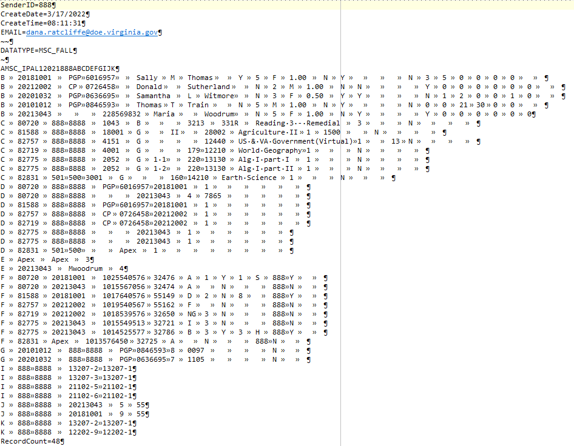
Sample File Layout
Notes:
Sample uploaded text file
The file is uploaded in SSWS (the Single Sign on Web System).
Several validation steps are performed and any errors found will be noted
All errors must be corrected within the text file then uploaded again
The final step is to verify the data.
Use the MSC, CTE, IPAL and SEDF Verification Reports, to verify the data

Slide 14
9 Record Types

Slide 15
Record Types
B Record – IPAL Reporting (Fall Only)
C Record - Courses
D Record - Sections
E Record – Other Provider or unlicensed teachers
F Record – Students
One record for each section the student is enrolled in or will be enrolled in
G Record – Administrators and Pupil Personnel (Fall Only)
I Record – Connecting Sections
J Record – Co-Op
K Record – Interdisciplinary Connecting Records
Notes:
The B Records is used for IPAL reporting. This crosschecks a teachers endorsement with the endorsements required to instruct the course.
Course level data is collected in the C Record. The SCED code is reported along with other data such as how long the class is taught and the semester. Each sections is related to a course so there can be multiple course records for the same SCED code.
The D Record collects the section information.
The teacher is connected to the section. Then the section is connected to the course.
The E Record is used to report teachers who are not licensed and contracted vendors.
The F Record is used to report students enrolled in a section. Each section a student is enrolled or has been enroll in will have a F record reported.
The G Record (only collected in the Fall) reports administrators and pupil personnel. A few examples of Pupil Personnel are:
School Counselors
School Psychologist
Librarians
Reading Specialist
ESL teachers
Or A Math Specialist
The I Record is used to connected 2 or more sections together. The sections are different levels of the same course being taught during the same class period. This is required for CTE sections.
An example is: Drafting 2 and Drafting 3 are taught during the same period.
The J Record is for reporting Co-op teachers and the number of students they oversee
Last, the K Record is used to report 2 different SCED codes taught together to make 1 course according to the divisions guidelines
An example is: SCED 01001 (English 9) is paired with SCED 01151 (Public Speaking) to create a specific course

Slide 16
Sample D and F Record Types
Section ID | Serving Division | Serving School | Teacher License Prefix | Teacher License Number | Local Provider ID | Teacher Role Code | Defined Class Type | Filler | Filler
Math5-01 | 016 | 0690 | CP | 00000000 | 4231 | 1
D Record
Section ID | Local Provider ID | State Testing ID | Local Student ID | Final Grade | Virtual Course Indicator | Dual Enrollment Flag | Work-based Learning | Governor’s Academy Code | Responsible Division | Credit Awarded Flag
Math5-01 | 4231 | 1012222678 | 1234567 | C |  | N |  |  |  | N
F Record
Notes:
This is a sample of what the D and F records will look like in a spreadsheet format
Data elements in the D Record are
Section ID which is a unique number assigned to each section
This is used to link the different record types together
Serving Division is the division the school is located in
Serving School is what school is providing the instruction
Teacher License Prefix and
Teacher License Number
Notice the license number is split into 2 separate fields
Local Provider ID is the staff number assigned by the division
Teacher Role Code shows the teachers role in the classroom. They can be the lead teacher, long term sub or a co-teacher in the class
Defined Class Type is who the class is intended for. An example would be a special ed class intended for specific learning disability students
There are 2 filler fields at the end of the record that must be included in the text file
F Record data elements are
Section ID
Local Provider ID
State Testing ID or the students STI
Local Student ID is the ID assigned for the student by the division
Final Grade is the grade the student receives at the end of the course. This is only reported on the end of year MSC.
Virtual Course Indicator is the code that describes the mode of instruction the student is receiving
Dual Enrollment Flag is for courses that receive college credit
Work-based Learning is a CTE and non-CTE related data element to report things like internships
Governor’s Academy Code is STEM related data
The Responsible Division is used to report the division the student is enrolled in. This is optional for LEAs but required for Regional Centers.
Credit Awarded Flag is used to show the student received credit for the course, not that they passed the course but received credit
Notice the Section ID is used to link the student to the section.

Slide 17
Reporting Timeline & Webpage Resources

Slide 18
Fall MSC
The as-of or snapshot date is October 1st
Report student schedules on October 1st
Report the teacher(s) in the classroom on October 1st
This pertains to IPAL
Collects data for MSC, IPAL and SEDF
Collection opens early October through the end of January

Slide 19
EOY MSC
EOY MSC should include fall, end of year and summer data
Final grades must be included for all courses in grades 6-12
B and G Records, teacher/staff data is not collected on the EOY MSC
Collects data for MSC and SEDF
Collection opens mid-May through mid-August

Slide 20
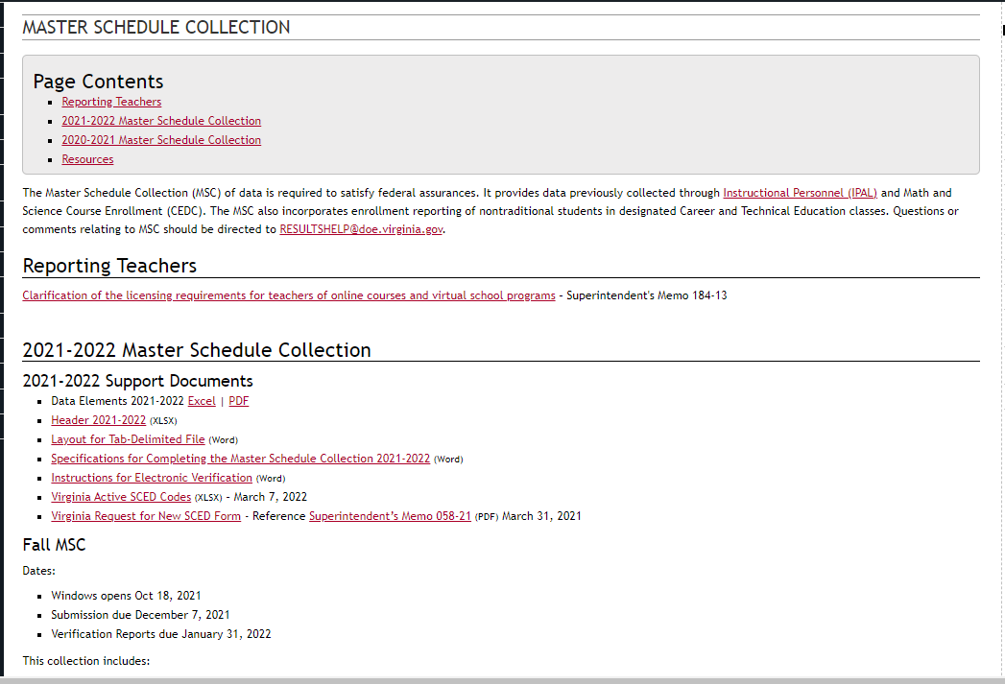
Webpage and Resources
Master Schedule Collection webpage
https://www.doe.virginia.gov/info_management/data_collection/master_schedule_collection/index.shtml
Notes:
Valid codes for the data elements can be found in the ‘Specification for Completing the MSC Documentation’ on the website.
There are other helpful documents such as
The Data Elements document lists some of the valid codes and formats. This also indicates if a data element are required for the Fall or EOY collection
The Data File Template is the template you can use when compiling the data. This is the same file I will use when explain the steps for converting an Excel file to tab delimited file.
The Layout for Tab Delimited File is pretty much the same as the Data Elements document but in a different format
The Instructions for Electronic Verification document will show step by step instructions for completing the local approval and Superintendent’s verification
The Virginia Active SCED Codes document is a list of all the valid codes that can be used for Virginia reporting
Below that is a link to request additional SCED code that are not already active in Va.

Slide 21
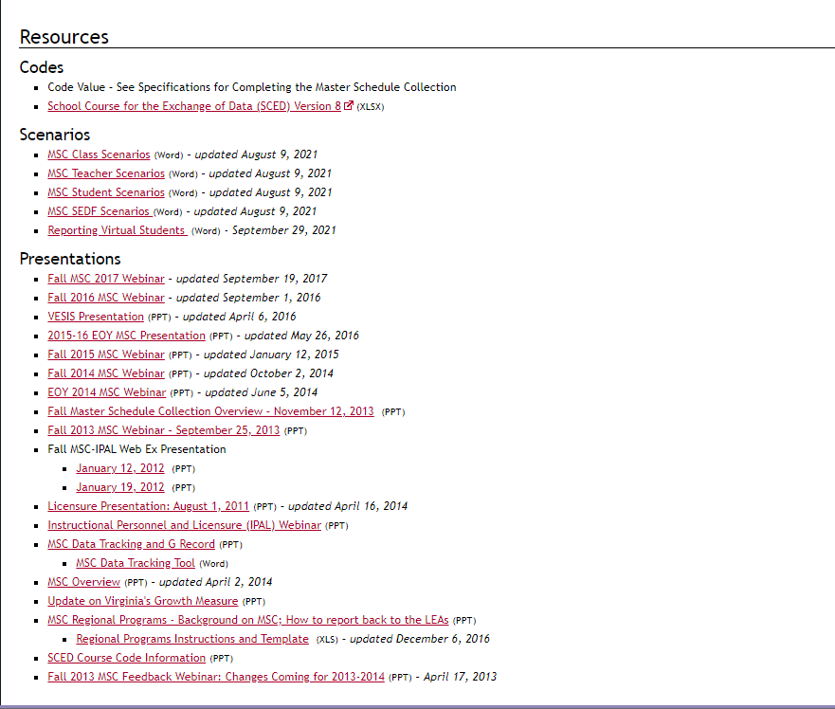
Notes:
The NCES SCED Finder Website is located under the section labeled Codes. This site contains all nationally used SCED codes. DOE has not activated all the codes found on the site but divisions can request to have additional codes be added.
Each Scenario file shows an example of how the different scenarios should be reported.
This includes teacher, section and student examples
Presentations will be located at the bottom of the page

Slide 22
Contact Information
MSC Webpage
https://www.doe.virginia.gov/info_management/data_collection/master_schedule_collection/index.shtml
Office of Data Services
Email: resultshelp@doe.virginia.gov
Dana Ratcliffe, Education Data Specialist, Office of Data Services
Email: dana.ratcliffe@doe.virginia.gov

Slide 23
Create the Tab Delimited Text File

Slide 24
Header and A Record
SenderID=888
CreateDate=3/17/2022
CreateTime=08:11:31
EMAIL=dana.ratcliffe@doe.virginia.gov
~~
DATATYPE=MSC_FALL
~
AMSC_IPAL12021888ABCDEFGIJK
Submission
Division#
School Year
Notes:
The header and A record is used to explain what collection is being reported, date the file is created, who created the file and what records are included.
The File Submission Type is either 1 for fall or 3 for EOY
Beginning School year is the first year of the new school year.
For Example: 2022 is the first year in the 2022-2023 school year
This will be used for the Fall and EOY collection
DOE assigned a division number to each LEA or regional center
The Section Type is the “record types” that are included in the file being submitted
Remember B Records are only reported in the Fall so the EOY submission will not list B as one of the record types being reported
Notice the submission, school year and division in the last line
The submission is 1 for fall
The school year is 2021, that is for the 2021-2022 school year
And The division# is 888. Again, DOE assigns this.

Slide 25
Converting an Excel spreadsheet to .txt
Highlight the data in the template starting in the first cell
Drag down and over to pick up all the data elements making sure to include columns A-M in this example
Even though the last two columns do not contain data, they must be selected as well
Select down to the last row
Again, all the data elements must be selected even if it doesn’t contain data
Copy the selected data
Notes:
Converting the spreadsheet to a tab delimited or txt file takes a couple steps.
Highlight the data in the spreadsheet or template starting in the first cell or A2.
Drag over to pick up all the data elements making sure to include the filler or retired columns. In this example it will be A-AA
Even though the last two columns do not contain data they must be selected as well
Select all the way down to the last row.
Again, all the data elements must be selected even if they don’t contain data.
Copy the selected data

Slide 26
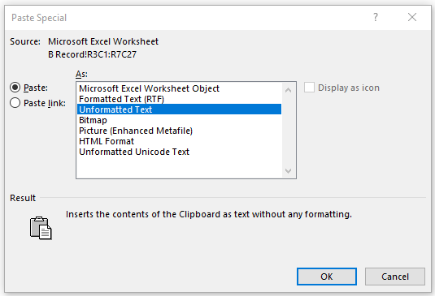
Open a new Word document
Paste the copied data from the template into the Word doc
Use the Paste Special option along with Unformatted Text
Turn on hide/show characters
Repeat the steps for each tab in the template
Notes:
Open a new Word document
Paste the data that was copied from the spreadsheet or Template into the blank Word page
Use the Paste Special option. If this isn’t used the data will not be in the correct format.
Choose Unformatted text as the format to paste the data.
On the top ribbon, make sure the Show/Hide feature is turned on. This helps when troubleshooting problems.
The Word file should look like this
Notice how things line up
Notice how there is a tab character when there isn’t any information or data to report
These are the filler or retired fields
Repeat the steps for each tab in the spreadsheet

Slide 27
Select all the data in the Word doc
Copy and past the whole Word document into Notepad
Add the header and A record
Save the file
Notes:
Copy everything in the Word document and paste it into Notepad
Notice how the D records go beyond the B records.
Add the header and A record if it hasn’t already be done
The last step is to save the file in text format using File/Save or File/Save As
This is the format required for any file uploaded in SSWS, not just MSC
Be sure to remember the location of the saved file

Slide 28
Uploading the Tab Delimited file
Log into SSWS
Scroll down the list of applications and click MSC Fall or EOY
Use the File Upload link on the right to submit a file
Notes:
Log in to SSWS
Select the MSC Fall or EOY Collection from the list you have access to
Select File Upload at the top of menu on the right
Next, locate the text file you created and saved then click Submit

Slide 29
Data validation
An email will be sent with the status of the uploaded file
Click View Errors or View Warnings
Review all errors and warning.
Errors must be fixed and a new file uploaded
Notes:
The collection manager will receive an email with the status of the uploaded file. It will be either successful or failed.
The first validation checks the formatting of the file.
The second validations pertain to the data being reported.
Any errors that are discovered during the validation process will show under View Errors or View Warnings in the right menu
Errors must be corrected within the text file and uploaded again.

Slide 30
Reports
Log into SSWS
Scroll down the list of applications and click either MSC Fall or EOY, IPAL or SEDF
Each has a report that must be reviewed
Click the Reports link in the right side menu
Notes:
The SSWS Manager must assign access to the reports to the different local approvers or staff members before they will see the Reports link
Reports that need to be reviewed
Log into SSWS if you are not already logged in
Scroll down the list of application and click either MSC, IPAL or SEDF. Each application has reports to verify.
Click the Reports link in the right side menu

Slide 31
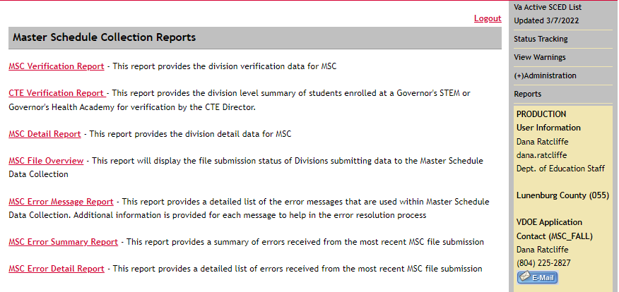
MSC Reports
The MSC Verification Report and CTE Verification Reports need to checked very closely
The other reports on this page can be used as a resource
Notes:
There are 2 reports under MSC that need to be verified
The first is the MSC Verification Report.
This report contains things like Dual Enrollment totals, virtual learning indicators and students who might be missing and not reported on the MSC
The CTE Verification Report is short and shows Governor STEM academy enrollment totals

Slide 32
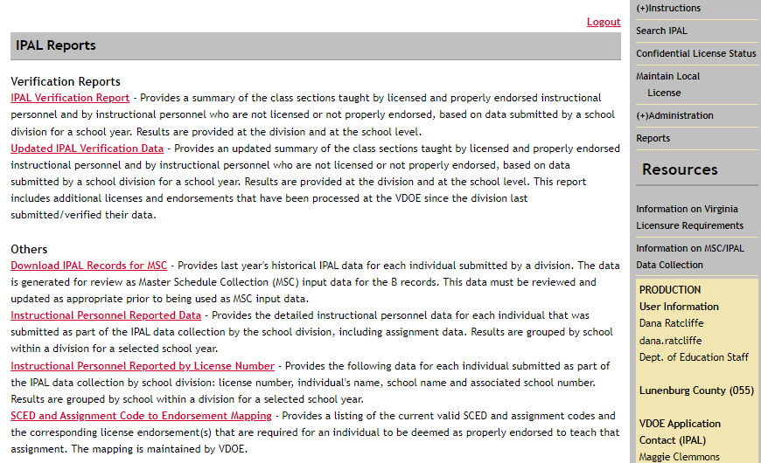
IPAL Reports
The IPAL Verification Report will list unlicensed or not endorsed teachers
The SCED and Assignment Code to Endorsement Mapping report will list each SCED code and the endorsements needed for the course
Notes:
The IPAL Verification Report is only available in the Fall
The verification report will listed totals of courses, staff and unlicensed or not properly endorsed teachers
The other helpful report is the SCED and Assignment Code to Endorsement Mapping.
This report lists each SCED code and the endorsement a teacher must hold to be properly endorsed for the course.

Slide 33
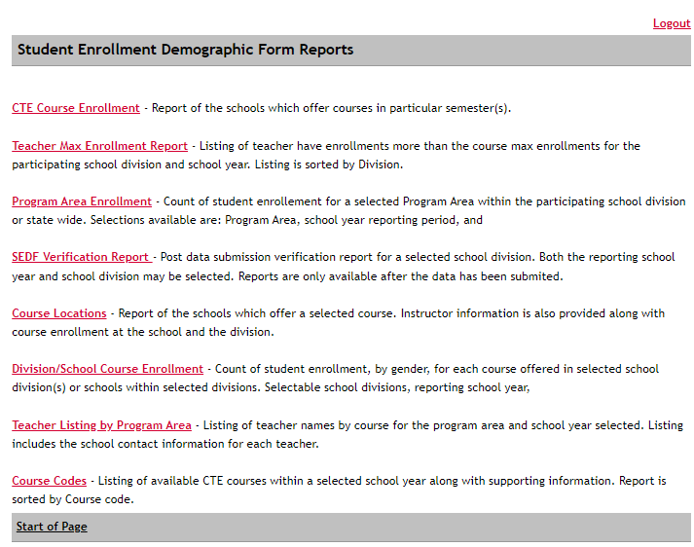
SEDF Reports
The SEDF Verification Report should be checked by a CTE director at the regional center
Notes:
The SEDF Verification Report should be reviewed by the CTE Director
The report will list any abnormalities pertaining to teachers and sections
The report also breaks each section down by race and gender

Slide 34
Internal Help
Assistance with file layouts and uploading files in SSWS
MSC Collection contact
Assistance with access to the MSC application in SSWS
SSWS Account Manager
SSWS back-up Account Manager
Assistance with setting up local approvers
SSWS Account Manager
SSWS back-up Account Manager
Assistance with setting up Superintendent Data Collection Approval (SDCA) account for Superintendent
SSWS Account Manager
SSWS back-up Account Manager

